Slide 1
Sepsis
Nurse Practitioner Led Outreach Team (NLOT) – 2022
William Osler Health System | Ontario Health Team

Slide 2
Sepsis
Severe infection
Spreading via the bloodstream
Can be bacterial, viral or fungal
Can originate from infections in the lungs, kidneys, skin, abdomen etc.

Slide 3
Who is at risk?
People with decreased immune system such as:
Cancer/Chemotherapy/Radiation
AIDS
Transplant patients
Steroid use
Infants/Seniors
Higher risk in seniors with multiple comorbidities
Burn Patients
Invasive devices: catheters, intubated
Hospitalized patients
Notes:
Seniors with multiple medical problems – diabetes, kidney or liver failure.
Due to antibiotic resistance, sepsis has now become harder to treat.

Slide 4
Pathophysiology
Inflammation extends beyond the infection site and affects the entire body
Disseminated Intravascular Coagulation (DIC):
Circulatory system begins to collapse causing microscopic clots in the small vessels in the body
Interferes with the body’s natural ability to break down clots
Leading to organ damage, circulatory system collapse and hemorrhages
Notes:
- DIC : circulatory system begins to collapse from bacterial toxins affecting capillary walls (leaking) + clots in small vessels + blood unable to clot as blood clotting factors used up = hemorrhages in many tissues

Slide 5
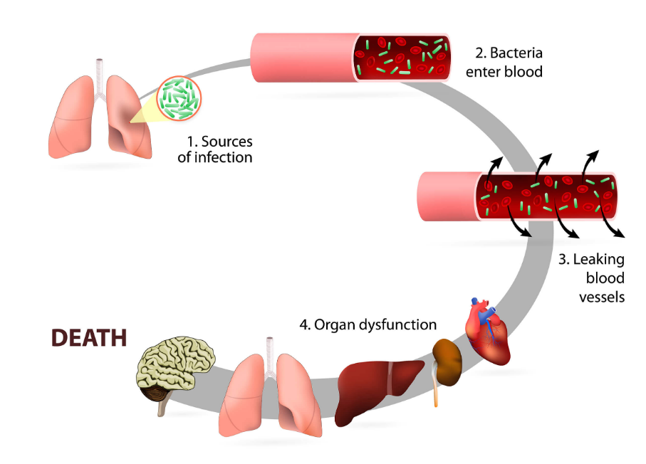
Sepsis
https://www.biovendor.com/circulating-biomarkers-in-critical-illness-and-sepsis?utm_source=google&utm_medium=organic
Notes:
- DIC : circulatory system begins to collapse from bacterial toxins affecting capillary walls (leaking) + clots in small vessels + blood unable to clot as blood clotting factors used up = hemorrhages in many tissues

Slide 6
Stage of Sepsis
Systemic Inflammatory Response Syndrome (SIRS)
A clinical response arising from a nonspecific insult
Temperature >38°C or <36°C
RR >20bpm
HR >90bpm
WBC >12,000 or <4,000
Monitor
Notes:
SIRS – a clinical response arising from a nonspecific insult to the body/homeostasis
Or >10% bands (immature WBC)
Looks like most LTC patients
CLOSELY monitor for S&S of progression to sepsis

Slide 7
Stage of Sepsis
Sepsis
2 SIRS
Confirmed or suspected infection
Monitor
Notes:
2 of the SIRS criteria
In many cases of sepsis the cause is not identified

Slide 8
Stage of Sepsis
Severe Sepsis
Sepsis
One or More Signs of End Organ Damage
Hypotension (SBP <90mmHg)
Which does respond to interventions
Monitor
Notes:
Signs of organ damage:
Hypotension; Mottled skin; ↓ Urine output; Elevated Cr; Lactic Acidosis; Elevated lactate (>2mmol/L); Abnormal ECG/Cardiac Dysfunction, Altered LoC; DIC; ARDS (acute respiratory distress syndrome); AKI; Capillary refill > 3sec
Usually requires aggressive treatment in a critical care area … unless a palliative route is chosen

Slide 9
Multiple Organ Failure
Lungs
Brain
Liver
Kidney
Heart
Blood
Acute Respiratory Distress Syndrome
Acutely altered LOC
GCS <15
Elevated LFTs
Elevated Bilirubin
Elevated Cr
Low urine output
(Despite fluids)
Hypotension
>40mmHg drop from baseline B/P
Decreased platelets
Increased INR
(without anticoagulation)
Notes:
Bacteremia: bacteria in blood
Viremia: virus in blood
Fungemia: fungus in blood
Terminology misused, does not show seriousness of sepsis → multiple organ failure
Liver unable to synthesize clotting factors or metabolize bilirubin
Tissue necrosis from hypoperfusion → amputation may occur
Elevated serum lactate >4mmol/L

Slide 10
Stage of Sepsis
Septic Shock - High Mortality Rate
Severe sepsis with persistent:
Signs of End Organ Damaged
Hypotension (SBP <80mmHg)
Which is not responsive to interventions (fluids)
Vasopressor therapy needed to maintain MAP >65mmHg
Lactate >4mmol/L
Notes:
Signs of organ damage:
Hypotension; Mottled skin; ↓ Urine output; Elevated Cr; Lactic Acidosis; Elevated lactate (>2mmol/L); Abnormal ECG/Cardiac Dysfunction, Altered LoC; DIC; ARDS (acute respiratory distress syndrome); AKI; Capillary refill > 3sec

Slide 11
Recognition
If sepsis is suspected or confirmed it is crucial to monitor closely for signs & symptoms of rapid progression
Frontline staff (nurse/PSW) are often 1st to recognized sepsis and/or risk of sepsis
Early recognition and rapid response are essential to successful treatment of sepsis

Slide 12
Symptoms
Fever or very low body temperature
Fever is sometimes absent in the elderly
Chills/Rigors
Abnormal vital signs (↑ HR, RR, ↓ B/P)
Decreased urine output
Confusion
Rash

Slide 13
Diagnosing
Determine the cause:
Location
Causative agent
Cultures: Blood, Urine, Sputum, Wound, CSF
Diagnostic Tests: X-Rays, CT Scan, Ultrasound
Laboratory Tests: CBC, Lytes, Cr, INR, LFTs
Notes:
WBC >12,000 or <4,000
Greater than 10% bands (immature WBC)

Slide 14
Treatment
Antibiotics
Supportive Care:
Intravenous fluids
Ventilator
Dialysis
Drugs for circulatory failure
Parenteral nutrition

Slide 15
Why is this important
Early recognition and rapid response are essential to the successful treatment of sepsis
Prognosis depends on: age, health status, speed of diagnosis and type of organism
Improving outcomes depends on every provider involved in care (including nursing/PSW)
Notes:
Up to 40-60% of patients with septic shock die within 30 days.
The earlier the treatment is initiated, the more favourable the outcome.
Identification of sepsis must often be made outside the ICU
All frontline assessments need to take into account the sign and symptoms of sepsis.

Slide 16
References
Guyton, A., & Hall, J. (2000). Textbook of Medical Physiology (p. 260). W.B. Saunders Company (10th Ed.).
Mayo Clinic Staff (July 24, 2009). Sepsis., from http://www.mayoclinic.com/health/sepsis/DS01004
Nelson, D., LeMaster, T., Plost, G., & Sahner, M. (2009). Recognizing Sepsis in the Adult Patient. American Journal of Nursing, 109 (3)., from http://journals.lww.com/ajnonline/Fulltext/2009/03000/Recognizing_Sepsis_in_the_Adult_Patient.34.aspx

Slide 17
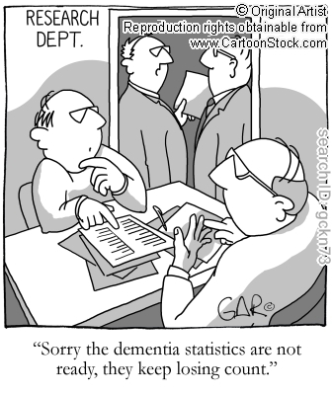
Questions?

