Slide 1
Hypodermoclysis
Nurse Practitioner-Led Outreach Team

Slide 2
Hydration
55-65% of body mass is water
Water is essential for life
Adults lose 2.5L per day through:
Perspiration
Breathing
Elimination
Food and fluids ingested replace what the body loses
Notes:
Seniors is less 1.7L

Slide 3
Dehydration
Occurs with:
Loss of body water
Water Loss and/or salt + water loss
Increased fluid loss + decreased fluid intake
Seniors are at a higher risk of dehydration due to:
Decline in total body water
Alteration in water regulation
Decreased thirst
Decreased ability to respond to temperature changes

Slide 4
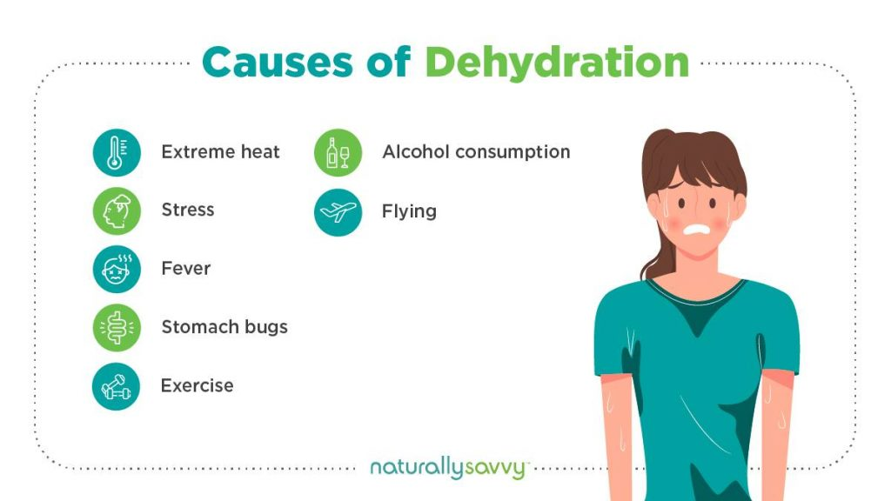
Dehydration
Causes:
Vomiting
Diarrhea
Malnutrition
Fever
Excessive perspiration
Burns
Increased Urination
Uncontrolled DM, Medications (Diuretics, Antihistamines), Alcohol)

Slide 5
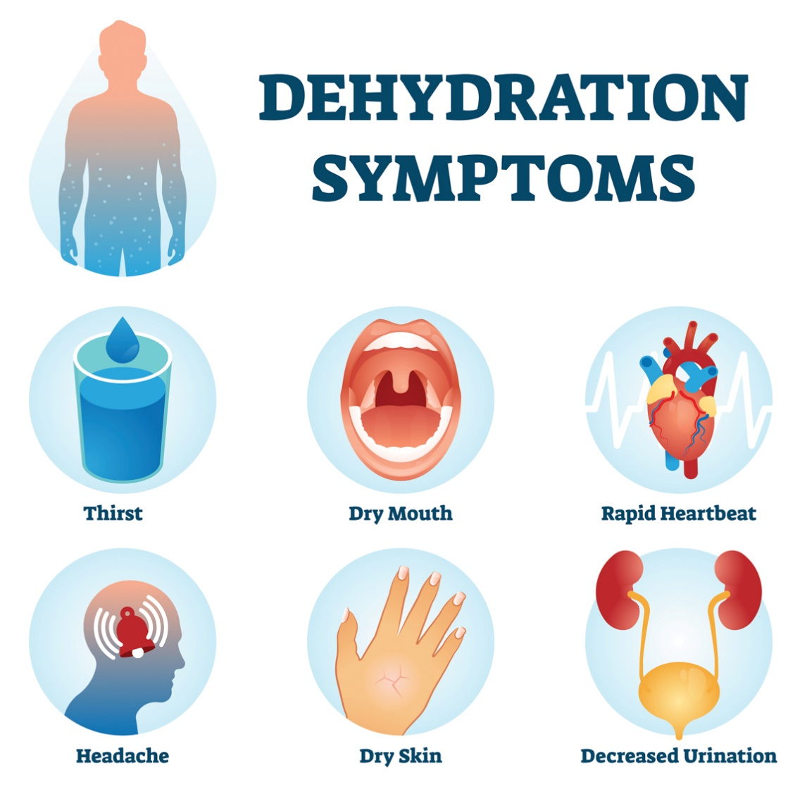
Dehydration
Symptoms:
Thirst, dry mouth
Loss of appetite
Dry axilla, decreased perspiration
Dry mucous membranes
Sunken eyes
Dark urine, low output
Fatigue/Weakness
Muscle cramps
Headaches, Dizziness
Nausea
Increased HR, RR and/or decreased B/P

Slide 6
Dehydration
Complications:
Kidney failure
Hypovolemic shock
Seizures
Coma
Cerebral edema (swelling of the brain)
Notes:
Cerebral edema – hypotonic, cells swell

Slide 7
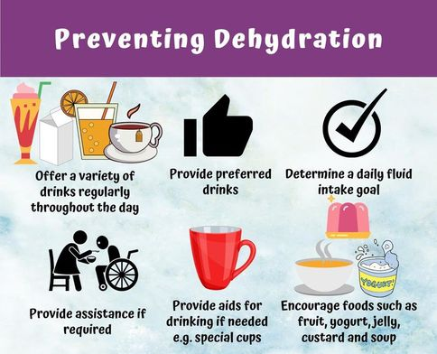
Dehydration
Treatment
Replace lost water and electrolytes
Prevention:
Maintain fluid intake
Prevent/Treat Illness
Heat
https://www.bda.uk.com/resource/hydration-matters.html

Slide 8
Hypodermoclysis
Subcutaneous administration of fluids
Slow rate of fluid update (1mL/min)
Up to 3L/day divided between two separate sites
Has been found to be AS efficacious as intravenous (IV) in some studies
Indications:
Patients who are unable to take adequate fluid orally
Mild to moderate dehydration

Slide 9
Hypodermoclysis
Advantages:
Low cost
More comfortable compared to IV
Simple insertion
Administration is possible in nearly any setting
No risk of thrombophlebitis
No evidence of risk of septicaemia
Can be started/stopped at anytime without risk of clot formation

Slide 10
Hypodermoclysis
Disadvantages:
Only 3L per day
Limitation with respect to the type of fluid
Localized edema is common
Possibility of local reactions

Slide 11
Hypodermoclysis
Contraindications:
NOT indicated when large and/or rapid amounts of fluids are needed
Severe congestive heart failure and/or pulmonary edema
Clotting/Bleeding disorders

Slide 12
Hypodermoclysis
Adverse Effects:
Subcutaneous edema
Fluid overload
Cellulitis
Puncture of blood vessels
Localized pain/discomfort

Slide 13
Hypodermoclysis
Administration:
Continuous administration – 1.5L/day per site
Periodic bolus – 1L overnight, no faster than 1L in 2hr
Given by pump or gravity
Fluids:
Normal Saline
½ Normal Saline
2/3 + 1/3
KCL (small amt)
NO D5 or D10

Slide 14
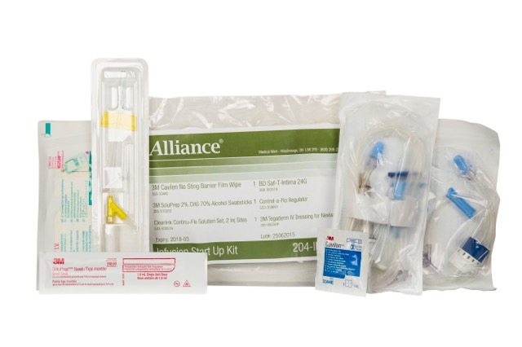
Hypodermoclysis
Equipment:
Solution bag
Tube w/ drip container
21-27gauge butterfly needle
Skin prep and sterile occlusive dressing
Pump (optional)
Notes:
Hyaluronidase can be used to increase fluid absorption (150u per 1L). Decreases the viscosity of the connective tissue = increased diffusion of fluid for about 24-48hrs.

Slide 15
Hypodermoclysis
Technique:
Explain the procedure to patient
Select infusion site – 1 inch fat fold (abdomen/thigh/back/arms)
Wash hands
Prime the tubing with the solution
Clean insertion site with skin prep/alcohol
Insert needle (bevel up) at 45-60 degree angle
Secure needle and tubing with occlusive dressing, and date the dressing
Adjust fluid rate as ordered
Document fluid infusion on medication chart
Check patient after 30min-1hr for signs of edema or leakage, fluid overload, fluid infusion rate
Notes:
Hyaluronidase can be used to increase fluid absorption (150u per 1L). Decreases the viscosity of the connective tissue = increased diffusion of fluid for about 24-48hrs.

Slide 16
Clysis PEARL
Drip rate calculation:
Drip rate= [volume to be infused x drop per ml (tubing)]
infusion time (min)
http://www.medical-calculators.co.uk/driprate.html

Slide 17
PEARLS
Check dressing, insertion site, cap, clips
PICC:
Heparinized
If pulled out: pressure for bleeding, dressing, examine tip (? Intact)
Long term but NOT life long
See Medical Pharmacies Guidelines for Hypodermoclysis

Slide 18
Education Tool (Written)
Subcutaneous Hydration (Hypodermoclysis) Guideline
Section 4: Procedure
Section 5: Care and Maintenance

Slide 19
Education Tool (Video)
Hypodermoclysis Insertion and Care for Nurses
https://www.youtube.com/watch?v=Ear9D9yI6rI
Hypodermoclysis (HDC): How to Prime, Flush, Infuse https://www.youtube.com/watch?v=rICqkQJ_XfI

Slide 20
Supplies
Suppliers:
Calea Ontario Medical Supply (OMS)
Supply List Prescription Supply List

Slide 21
References
Lybarger, E. (2009). Hypodermoclysis in the Home and Long-term Care Setting. Journal of Infusion Nursing, 32(1): 40-44.
Remington, R., Hultman, T. (2007). Hypodermoclysis to Treat Dehydration: A Review of the Evidence. Journal of the American Geriatric Society, 55(12): 2051-2055.
Sasson, M., & Shvartzman, P. (2001, Nov). Hypodermoclysis: An Alternative Infusion Technique. American Family Physician,16(9):1575-1579. Obtained from http://www.aafp.org/afp/2001/1101/p1575.html on July 12, 2010
Schols, J., DeGroot, C., VanDer Cammen, T., Rikkert, M. (2007). Preventing and Treating Dehydration in the Elderly During Periods of Illness and Warm Weather. Journal of Nutrition, Health & Aging, 13(2): 150-157.
Thomas, D., Cote, T., Lawhorne, L., Levenson, S., Rubenstein, L., & Smith, D. (2008). Understanding Clinical Dehydration and Its Treatment. Journal of the American Medical Directors Association, 9(5): 292-301.

