Slide 1
Foley, Suprapubic catheter & Nephrostomy tube Care and Management in LTC
Created by: Zankhana Patel, RN, MSN
William Osler-Nurse Practitioner Led Outreach Team (NLOT)
August 14, 2023

Slide 2
Learning Objectives
To identify the different types of indwelling catheters and its indications
To outline foley catheter insertion procedure and maintenance strategies
To learn about suprapubic catheter change and nursing assessment and management
To explore best practice guidelines related to nursing assessment and management of Percutaneous nephrostomy tube

Slide 3
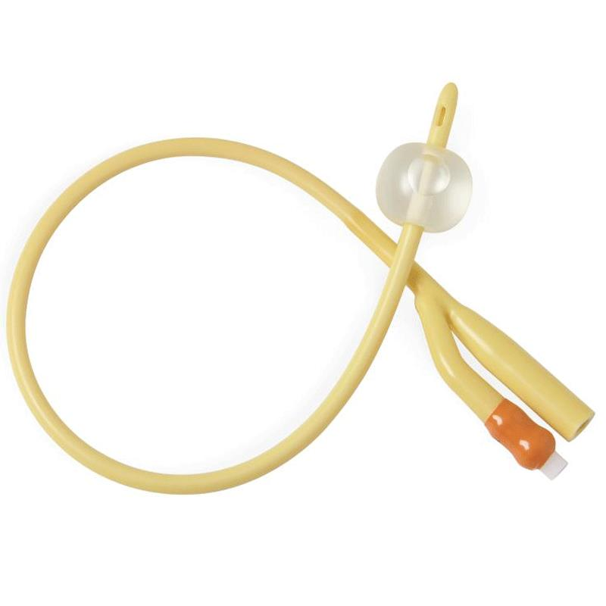
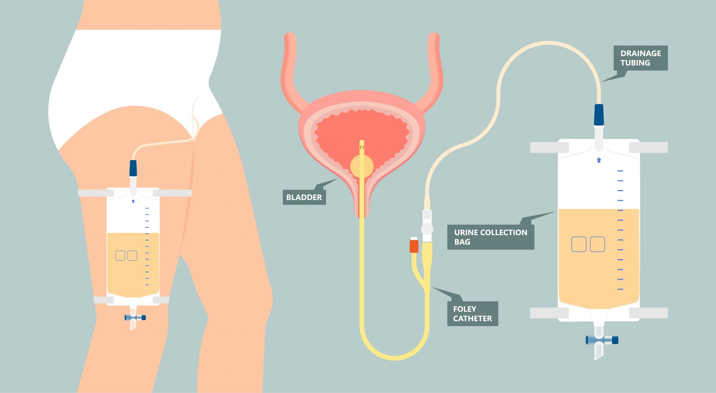
What is a Foley catheter?
Is a thin, flexible tube that drains urine from your bladder.
The catheter joins your bladder to a special bag outside of your body

Slide 4
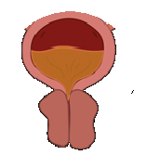
When is a catheter needed?
A Foley catheter can be used for a number of health problems:
Obstruction: Something blocking the urine from coming out. The blockage might be a narrow part of the urethra, enlarged prostate or bladder stones
Urinary retention related to neurogenic bladder: Unable to empty bladder
Immobility due to a serious injury, illness, or surgery.
Long-term indwelling urinary catheter (more than 30 days)
Continuous bladder irrigation
Notes:
Urinary retention due to obstruction,
Neurogenic bladder – unable to empty bladder due to brain (stroke, degenerative diseases like MS, spinal cord injury or nerve damage)

Slide 5
Types of catheters:
INTERMITTENT or SHORT TERM CATHETER
In/Out/Straight: Used for a one time use to empty the bladder
INDWELLING :
2-way catheter:
Suprapubic catheter: Small hole in the abdomen to the bladder to drain urine.
Coude/Tiemenn catheter: The tip of the catheter is curved to deal with prostatic curve in male patients. It is used for enlarged prostates or BPH
3-way catheter or continuous bladder irrigation catheter: Used if gross hematuria or clot retention is suspected.
Notes:
INTERMITTENT or SHORT TERM CATHETER: In/out/ straight : used for a one time use to empty the bladder
INDWELLING :
- Suprapubic catheter: small hole in the abdomen to the bladder to drain urine. (long term usage if unable to tolerate urethral catherization
-Coude/tiemenn catheter – the tip of the catheter is curved to deal with prostatic curve in male patients. It is used for enlarged prostates or BPH
3-way catheter or continuous bladder irrigation catheter: is used if gross hematuria or clot retention is suspected. One port of the catheter is used for continuous irrigation

Slide 6
Notes:
Straight catheter – IN and OUT or Red rubber
2 way foley catheter – can be used for urethral catheterization and suprapubic.
Coude or tiemenn tipped catheter – end of catheter is curved to help with insertion with large prostates.
3 way catheter or CBI catheter – additional port which is used for irrigate the bladder continuously, and drain via the last port

Slide 7
Inserting a catheter for a MALE
Maintain sterile technique & position patient in supine position and expose genitals.
Open sterile catheter tray, open catheter and place on sterile area.
Wear sterile gloves, test catheter balloon with the sterile water syringe.
Clean genitals with prep solution (iodine) provided with tray
Place drape with window over the genital.
Generously apply lubricant to catheter
Hold penis with non dominant arm and with dominant arm slowly insert the catheter ALL THE WAY to the Y end of the Foley or bifurcation.
IF urine output is noted, inflate catheter balloon with STERILE WATER, then slowly pull forward the catheter to ensure correct placement.
Never inflate the balloon in a male patient if the catheter is not fully inserted to the Y or bifurcation
Secure catheter tubing to reduce pressure on urethra, preventing tissue injury
Attach catheter to urine bag.

Slide 8
Coudé/Tieman Urinary Catheter
Perform the procedure as for standard catheter insertion except keep tip of curved tip catheter up.
Gently advance the curved tip catheter into the urethra using a large amount of water-soluble lubricant. Maintain the catheter in the 12 o'clock position during passage (curved tip pointing up).
Insert the curved tip as per normal catheterizations, until urine return is obtained, then insert 2-3 inches more.

Slide 9
Inserting a catheter for a FEMALE
Wear gloves and position patient in frog legged position (bended knees, feet together and dropped to the side)
Maintain sterile technique & position patient in supine position and expose genitals.
Open sterile catheter tray, open catheter and place on sterile area.
Wear sterile gloves, test catheter balloon with the sterile water syringe.
Clean genitals with prep solution (iodine) provided with tray
Place drape with window over the genital.
Generously apply lubricant to catheter
Hold labia with non dominant arm and with dominant arm slowly insert the catheter approximately 2 inches.
IF urine output is noted, inflate catheter balloon with STERILE WATER, then slowly pull forward the catheter to ensure correct placement.
Secure catheter tubing to reduce pressure on urethra, preventing tissue injury
Attach catheter to urine bag

Slide 10
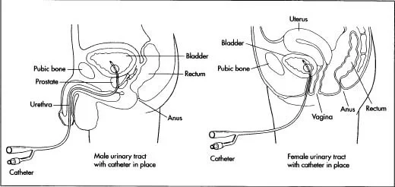

Slide 11
Suprapubic Catheter Change
Supplies:
Sterile catheterization tray
Urine drainage bag
2 Pair sterile gloves
Non- sterile gloves
Sterile water
Normal saline
10 mL empty syringe
Long term catheter (Size Fr 16)
Lubricant gel
Gauze

Slide 12
Videos
How to insert catheter MALE
https://www.youtube.com/watch?v=OsVL10kIh8w
How to insert catheter FEMALE
https://youtu.be/T6ZDBpVSg3U
Suprapubic Catheter Change
Change of a suprapubic catheter - YouTube

Slide 13
Troubleshooting: Nursing Interventions
Ensure urine output is adequate (approximately 30ml/hr)
Monitor for any blood/blood clots in urine (hematuria) or genital area
Attempt to irrigate or change the catheter once order received
Ensure no kinks or bends in tubing, and that the urine bag is below catheter site
No urine output and/or abdominal pain
Always expect some urine return if the catheter is in the bladder.
If there is no urine return, urinary bladder assessment must be completed [assess for signs and symptoms of urinary retention (bladder distention and abdominal pain)].
Notify prescriber if no urinary drainage
Notes:
Add more if needed.

Slide 14
Troubleshooting: Nursing Interventions
Observe for signs of urinary tract infection(UTI) (i.e. foul smelling urine, discharge around the insertion site, fever and chills)
Collect urine sample from a clean catheter bag in a sterile container prior to starting antibiotic treatment if UTI is suspected
When should you change the catheter?
When frequent and large blood clots are noted despite irrigation trial
Frequent UTIs should indicate for frequent catheter changes – done in collaboration w/ MD/NP
If catheter balloon does NOT deflate for removal?
Balloon malfunction is usually found in the balloon inflation port, the balloon drainage channel, or the balloon itself.
Common cause of the problem: Using saline to expand the balloon. With time, salt crystals from the saline precipitate in the various locations responsible for deflation failure.
Cutting off the inflation port with a pair of scissors. The balloon will promptly deflate if the obstruction involves a defective inflation port

Slide 15
Tips and tricks
If having trouble to advance catheters in males, get patient to take slow deep breaths and as patient is exhaling advance catheter all the way to the hub. If still meeting resistance, do not push the catheter any further or inflate the balloon. Notify MD/NP.
If having troubles with finding the urethra in females, bring 2 catheters, and place the bed in Trendelenburg position (head down feet up). If no urine output is noted within 5 to 6 cm of inserting the catheter you are likely in the vagina. Leave the catheter and use a new catheter and aim for above the Foley.

Slide 16
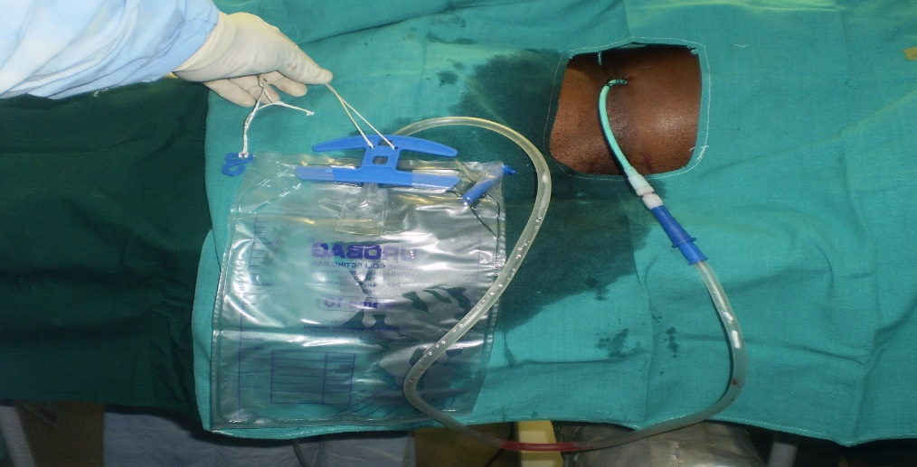
Percutaneous Nephrostomy Tube
Tube that is placed directly into the kidney through the skin
May be connected to the external drainage bag with a 3 way stopcock
May not be connected to drainage bag
Always keep tube site clean and dry
DO NOT take a bath
Flush the tube with 10mL NS pre-filled syringe daily

Slide 17
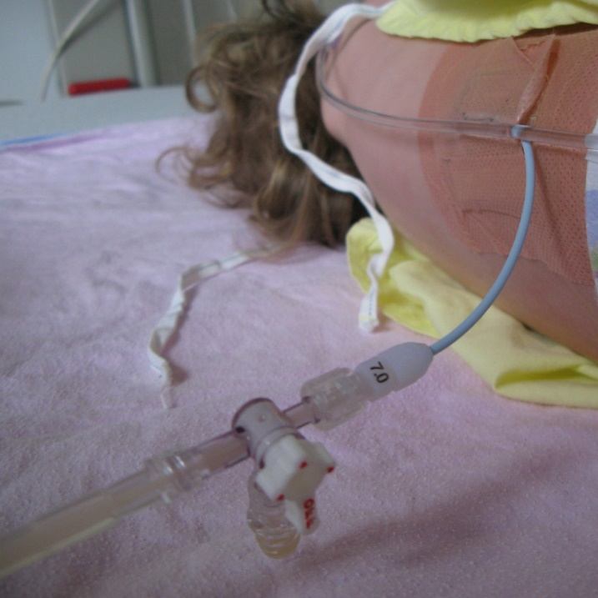
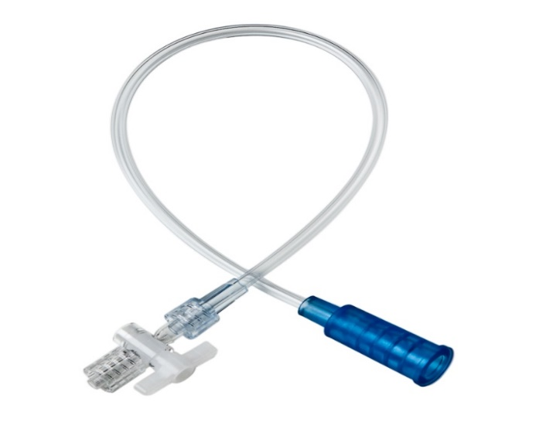
Nephrostomy Tube Care
Catheter & Cleaning Supplies:
Sterile gloves
Sterile gauze (size 4X4)
Medipore Adhesive Tape
Alcohol gauze
Sterile NS 10mL pre-filled syringe
Mild soap and warm water
Drainage leg bag/bedside drainage bag for nighttime
Luer-lock cap

Slide 18
Nephrostomy Tube Care
Cleaning Instructions:
Clean every other day or when soiled
May shower with site uncovered 7-10 days after tube insertion
Do NOT shower with site uncovered if site is red or has yellow/purulent drainage
Clean with mild soap and water in a circular motion (from center to outwards)
Cover with gauze pad and tape
Remove the old dressing while supporting the tubing
Wear gloves when changing dressing, tubes or bags
Inspect catheter insertion site and surrounding skin for:
Redness, foul-smelling odor, warmth, swelling, drainage
Upon application of new dressing, tape the catheter to the skin below the dressing
Check tubing for kinks. Remove if any present

Slide 19
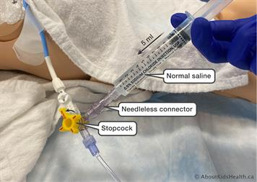
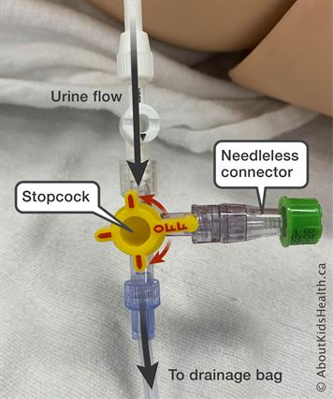
Nephrostomy Tube Care
Drainage bag
Keep drainage bag below nephrostomy tube to prevent reflux of urine
Keep bag off the floor to prevent contamination
Empty bag when it’s 2/3 full
Troubleshooting Tips
Use NS pre-filled 10mL syringe to flush the tube if not draining well
Be sure to flush without applying severe force/pressure

Slide 20
Nephrostomy Tube Care
Notify Physician/NP immediately if:
Fever > 100.4 F or 38 C
Abdominal pain during 1st week after insertion
New or worsening pain or discomfort around the catheter site
Redness, swelling or warmth around the catheter site
Large blood clots in urine
Catheter tube pulled out from the skin or suture securing tube comes free
Cloudy urine with strong odor
No drainage or continued decrease in urine output despite NS flush
Pain or difficulty flushing the tube
Persistent pain or soreness in back
How To Take Care Of Your Percutaneous Nephrostomy Tube - YouTube

Slide 21
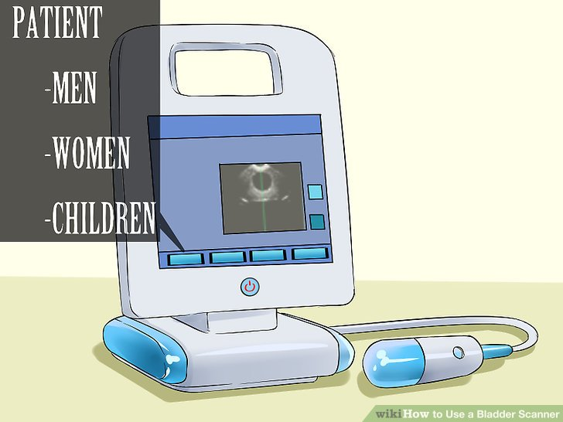
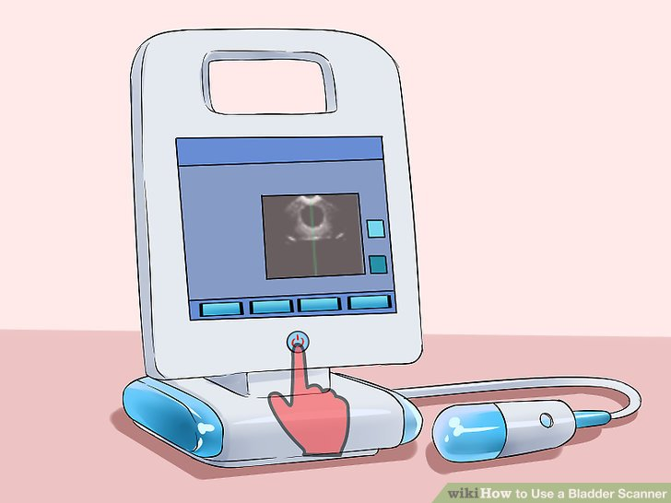
Bladder Scanner Use
Turn ON the system by pressing the Power button.
Enter the patient data a)Touch Patient button to enter patient management system. b) Select the patient gender by touching the gender icon.

Slide 22
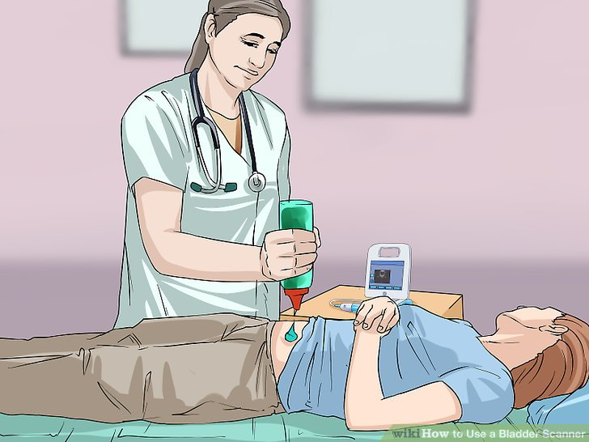
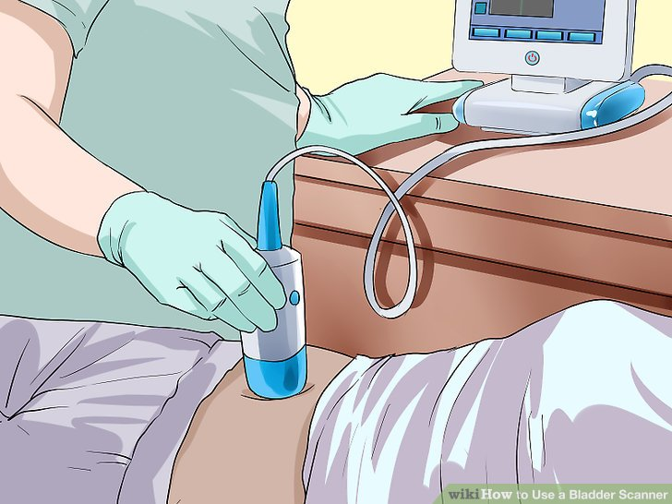
Bladder Scanner Use
3) Prepare the patient a) Have the patient lie in the supine position with abdominal muscles relaxed. b) Place an ample quantity of gel midline on the patient's abdomen, approximately 3 centimeter (1.2 in) above the pubic bone
4) Aim toward the bladder a) stand at the patient's right side. b) Place the probe on the gel and make sure the probe button is facing the patient's head directly. c) tilt the probe slightly toward the patient's tailbone so the scan clears the pubic bone.

Slide 23
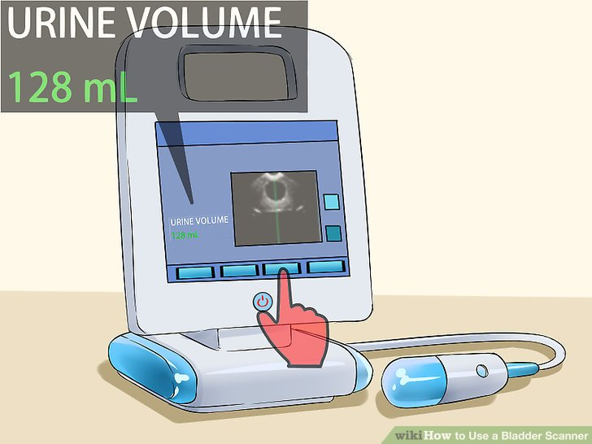
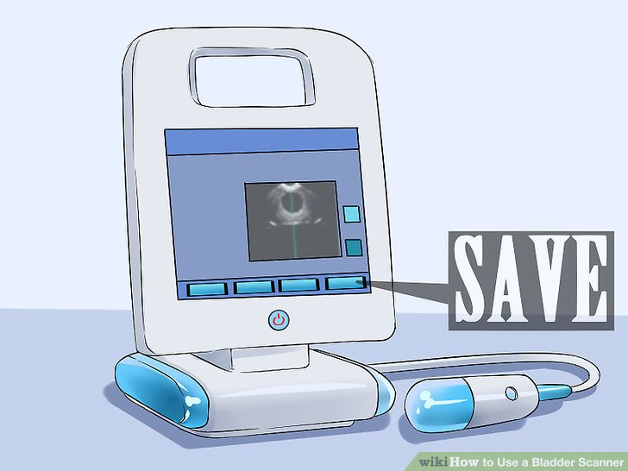
Bladder Scanner Use
5) Press the Scan button a) Press the probe button to start ultrasound scanning to locate the bladder b) Make sure the ultrasound bladder image is the biggest and centered. c) When you find the ideal ultrasound bladder image, press the probe button again. Pad Scan Bladder Scanner will start calculation automatically. d) When you hear a 'beep', the calculation is finished. The result of urine volume will be displayed.

Slide 24
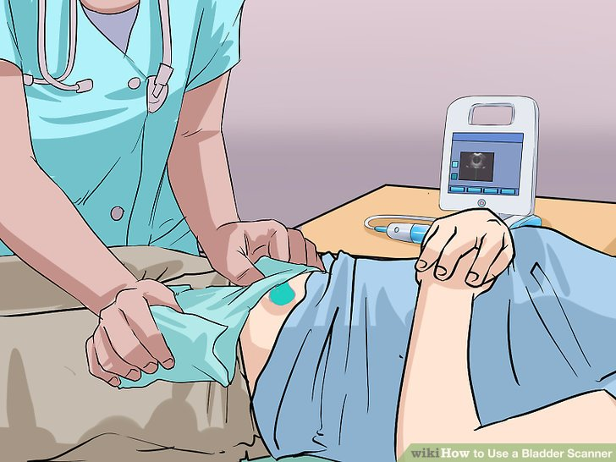
Bladder Scanner Use
6) Finish exam. Once you have completed the scan, wipe the ultrasound gel off the patient and the probe

Slide 25
References
How to MASTER the Foley Catheter Insertion + Advanced Tips & Tricks. (2022, August 25). Health and Willness. https://healthandwillness.org/foley-catheter-insertion/
Foley Catheter Placement and Care - What You Need to Know. (n.d.). Drugs.com. https://www.drugs.com/cg/foley-catheter-placement-and- care.html
BARD ® ADVANCE FOLEY TRAY SYSTEM Foley Catheter Insertion and Removal Sample Procedure Purpose. (n.d.). https://www.urotoday.com/images/catheters/tools/insertion_protocol.p df

