Slide 1
Created by: Zankhana Patel, RN, MSN
William Osler-Nurse Practitioner Led Outreach Team (NLOT)
August 22, 2023

Slide 2
Clinical Signs & Symptoms of Infection: Nursing Management

Slide 3
Learning Objectives
To identify the definition of infection
To outline common causes of infection
To discuss the general and specific S & S of infection
To discuss nursing assessment for foot ulcers and pressure injuries
To review nursing interventions related to prevention and management of infection

Slide 4
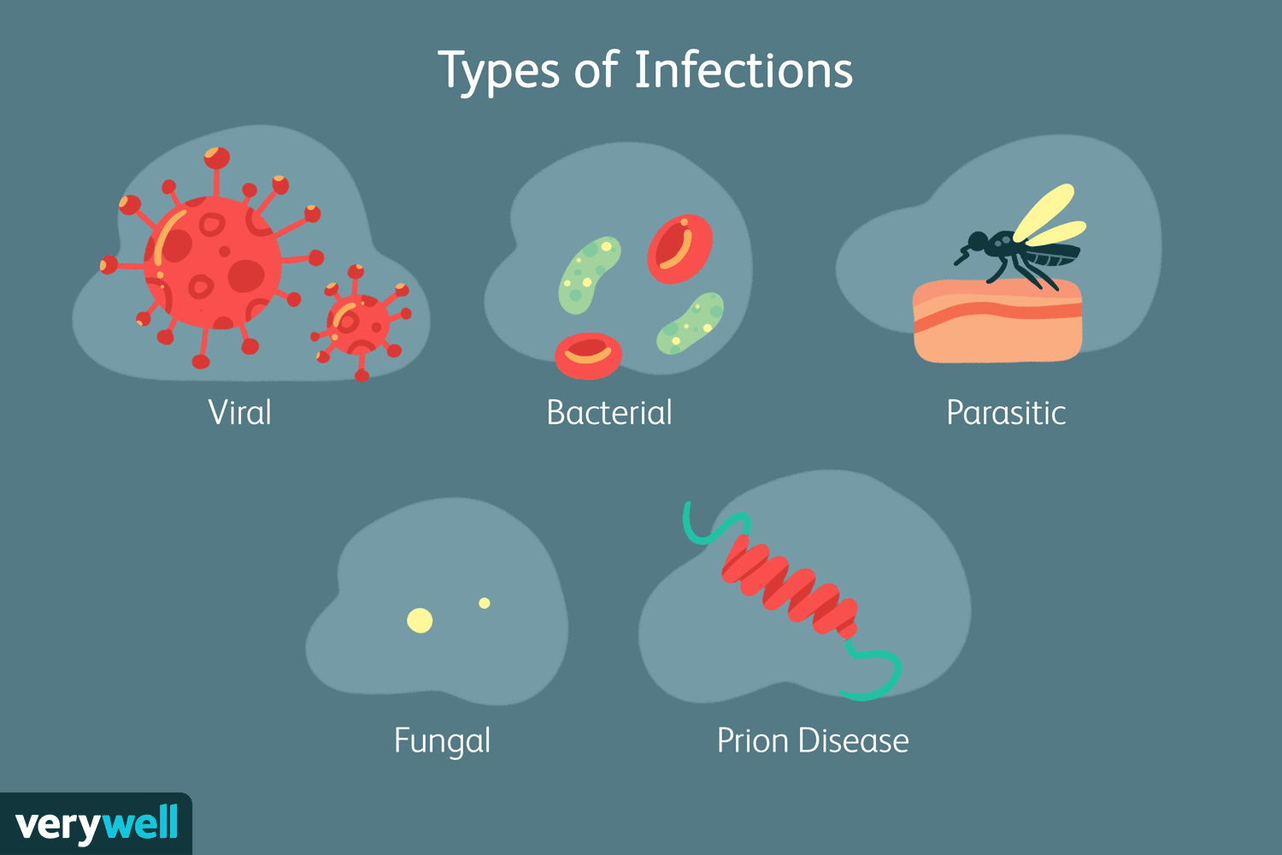
What is Infection?
An infection occurs when microorganism (i.e. virus, bacteria, fungus) enter a person’s body and multiply, causing illness, organ and tissue damage, or disease
Result of an interaction between a susceptible host and infectious agent
A clinical syndrome caused by the invasion and multiplication of a pathogen in the body.

Slide 5
Common Types & Causes of Infection

Slide 6
Stages of Infection

Slide 8
General S & S of Infection
Nursing Assessment
Malaise/fatigue (i.e., a feeling of discomfort, or lack of well-being),
Headache
Chills & fever [body temperature over 38 C : low grade or under 36; >38.5 C: high grade)
Lack of appetite
HR > 100 beats/minute, RR> 20/min, low BP < 90/60 mmHg
Hyperglycemia
Pain
Joint aches
Rash
Lab results: Elevated WBCs, C-reactive protein (CRP), Erythrocyte sedimentation rate (ESR), +ve wound/tissue culture
(Registered Nurses Association of Ontario [RNAO], 2016).

Slide 9
General S & S of Infection

Slide 10
Specific S & S of Infection
Nursing Assessment
Wound or Incision: Redness, warmth, swelling, drainage from a wound
Yellow or green drainage (i.e., purulent drainage)
Neurological: Observe for mental status & changes in behaviour (i.e. New confusion and/or worsening level of consciousness).
Respiratory: Sore throat, new cough and/or productive cough of purulent sputum, SOB, RR> 20/min
Genitourinary: Malodorous, cloudy, or bloody urine, with increased frequency, urgency, or pain with urination
Gastrointestinal: Loss of appetite, nausea, vomiting, or diarrhea. Discolored or unusually malodorous feces.
(RNAO, 2016).

Slide 11
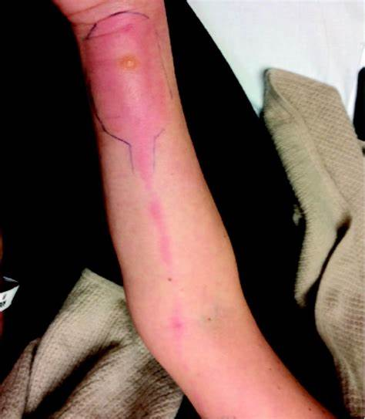
Assessment of Foot Ulcers: S & S of Infection
Non-limb-threatening Infection
Superficial infection
Non-healing
Bright red granulation tissue
Friable and exuberant granulation
New areas of breakdown or necrosis
Increased exudates
Bridging of soft tissue and the epithelium
Foul odour from discharge
(RNAO, 2016).

Slide 12
Assessment of Foot Ulcers: S & S of Infection
Limb-threatening Infection
Deep wound infection
Pain
Swelling, induration
Erythema (> 2 cm)
Wound breakdown
Increased size or satellite areas undermining or tunneling
Probing to bone
Anorexia
Flu-like symptoms
Erratic glucose levels
(RNAO, 2016).

Slide 13
Assessment of Foot Ulcers: S & S of Infection
Systemic infection
In addition to deep wound infection symptoms:
Fever
Rigour
Chills
Hypotension (BP < 90/60 mmHg)
Tachycardia HR > 100 bpm
Hypoxia SpO2 < 90%
Multi-organ failure related to sepsis
(RNAO, 2016).

Slide 14
Physician/NP Communication: SBAR
Situation:
What is the concern?
Background:
What do you know?
Action/Assessment:
What did you do?
Assessment
Interventions
Recommendation/Request:
What help is needed?

Slide 15
What is Sepsis?
Severe infection spreading via the bloodstream
Bacterial, Viral; Fungal
Infections in lungs, kidney, skin, abdomen etc. can spread and lead to sepsis
If suspected/confirmed:
It is CRUCIAL to monitor closely for signs & symptoms of rapid progression
Nurse is often the first to recognize sepsis as well as risk of sepsis
Early recognition and rapid response are essential for successful treatment of sepsis

Slide 16
Stages of Sepsis
Systemic Inflammatory Response Syndrome (SIRS)
Systemic inflammation
2 of the following:
Temp >38 or <36
HR >90
RR >20
Elevated wbc or low wbc
Sepsis
Previous criteria
Plus probable or confirmed infection
3. Severe Sepsis
Previous criteria
Plus, S&S of organ failure
Lungs: Acute respiratory distress
Brain: acutely altered mental status, GCS<15
Liver: elevated LFT & bilirubin
Kidney: elevated Cr, low urine output (despite fluid)
Heart: Hypotension, drop from baseline BP >40mmHg
Hematologic: decreased platelet, increased INR (without anticoagulation)

Slide 17
4. Septic Shock
Previous criteria
Plus hypotension (which doesn’t respond to fluid resuscitation)
High mortality rate

Slide 18
Sepsis: Signs and Symptoms
Fever or very low body temperature
Temperature greater than 38°C or lower than 36°C
Chills/Rigors
Increased heart rate
Heart rate greater then 90bpm/min
Increased respiratory rate
Respiratory rate greater than 20bpm/min
Severe Hypotension
Systolic blood pressure lower than 90mmHg
Hypoxia SpO2 < 90%
Decreased or absent urine output
New onset of confusion
Rash
Elevated WBCs or low WBCs
SEPSIS
S: Slurred speech or confusion
E: Extreme shivering or fever
P: Passing NO urine all day
S: Shortness of breath
I: It feels like you’re going to die
S: Skin mottled or discoloured

Slide 20
Assessment for Infection: Pressure Injuries
People with pressure injuries are at increased risk for infection.
Assess pressure injuries for signs and symptoms of infection (i.e., superficial critical colonization/localized infection or deep and surrounding infection/systemic infection) on initial examination and at every visit, including at every dressing change.
Regular pressure injury assessments allow interprofessional teams to identify and treat wound infections while they are still in the early stages of development.
An assessment of the presence and degree of the person’s pain must be included as a component of any assessment for infection.
To guide the use of appropriate anti-infective agents, it is important to obtain a semi-quantitative wound culture swab (or tissue culture, in appropriate settings).
Prior to obtaining a sample, the wound bed should be cleaned of debris.
Tissue cultures and swabs should only be done once a clinician has reviewed the person’s wound history, conducted a physical exam of the pressure injury, and assessed the wound for signs of symptoms of infection.
(RNAO, 2016).

Slide 21
Nursing Interventions
General head to toe assessment
Pharmacological (antibacterial, antiviral, or anti-fungal agents)
Glycemic control
Diet high in protein and vitamin C (promotes healing)
Pain management
Appropriate wound dressings
Frequent vital signs monitoring
Adequate hydration

Slide 22
Infection Prevention Strategies
Strict compliance with hand hygiene, universal and isolation precautions
Minimizing the risk of catheter contamination and duration
Meticulous skin care
Education to staff
Surveillance of nosocomial infection rates
Prophylactic antibiotic therapy may be given

Slide 23
References
Registered Nurses Association of Ontario (2016). Clinical Best Practice Guidelines: Assessment and Management of Pressure Injuries for the Interprofessional Team. Retrieved on August 17, 2023 from Pressure_Injuries_BPG.pdf

Slide 24
Thank You!

