Slide 1
Created by: Zankhana Patel, RN, MSN
William Osler-Nurse Practitioner Led Outreach Team (NLOT)
July 19, 2023

Slide 2
Ostomy Care and Management

Slide 3
Learning Objectives
To learn the difference between types of ostomies
To identify the characteristics of a healthy stoma
To discuss the differences between one-piece and two-piece Ostomy system
To learn about ostomy care and maintenance including nursing care priorities

Slide 4
RNAO BPG: Supporting Adults Who Anticipate or Live with an Ostomy
Colostomy: Portion of patient’s colon is brought through the abdomen and everted to create a stoma
Ileal conduit: Portion of patient’s ileum is brought through the abdomen and everted to create a stoma.
permanent or temporary and allows the passage of urine into an external pouching system
Ileostomy: Portion of patient’s ileum is brought through the abdomen and everted to create a stoma.
Permanent or temporary and allows the passage of stool into an external pouching system
(Registered Nurses Association of Ontario [RNAO], 2019)

Slide 5
CHARACTERISTICS OF A STOMA
Shape – round, oval, or irregular; raised, flush or retracted stoma on abdomen.
Sensation – no feeling in the stoma because there are no nerve endings. If skin around the stoma is irritated, there may be tenderness or pain.
Location – depends where in the bowel the stoma is created and the anatomy of the patient.
Output– depending on the type of ostomy, there will be movement of stool, gas, or urine. It will be involuntary – there is no control.
Stitches – may or may not be seen around the base of the stoma. They usually dissolve in 7 to 10 days after surgery.
Peristalsis – slight movement of the stoma may be seen as waste passes through the bowel and stoma.
May be permanent or temporary
(Ostomy Canada Society, 2023)

Slide 6
CHARACTERISTICS OF A STOMA
STOMA APPEARANCE
Texture – moist and smooth like the tissue inside your mouth.
Pink/red in color → The blood supply is very close to the surface of the stoma. It is normal to see traces of blood when the stoma is cleaned or rubbed.
Turgor → Ability to change shape and return to normal appearance after lightly touching stoma (elasticity)
PERIOSTOMY SKIN
Should be intact = Unbroken Skin
Assess for redness, irritation, bruising, lesions (occurs from chronic moisture irritation)
STOMA SIZE
Vary in size due to many different factors including location in the bowel, body habitus, edema
Important to know the size of the stoma when choosing the appropriate appliance.
(Ostomy Canada Society, 2023; RNAO, 2019)

Slide 7
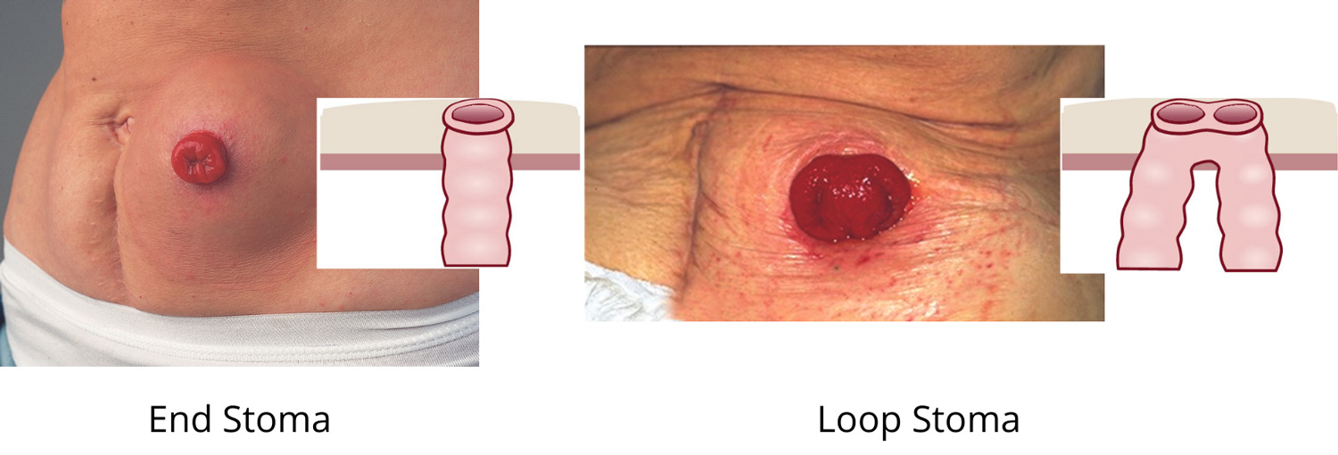
Healthy Stoma
(Ostomy Canada Society, 2023)

Slide 8
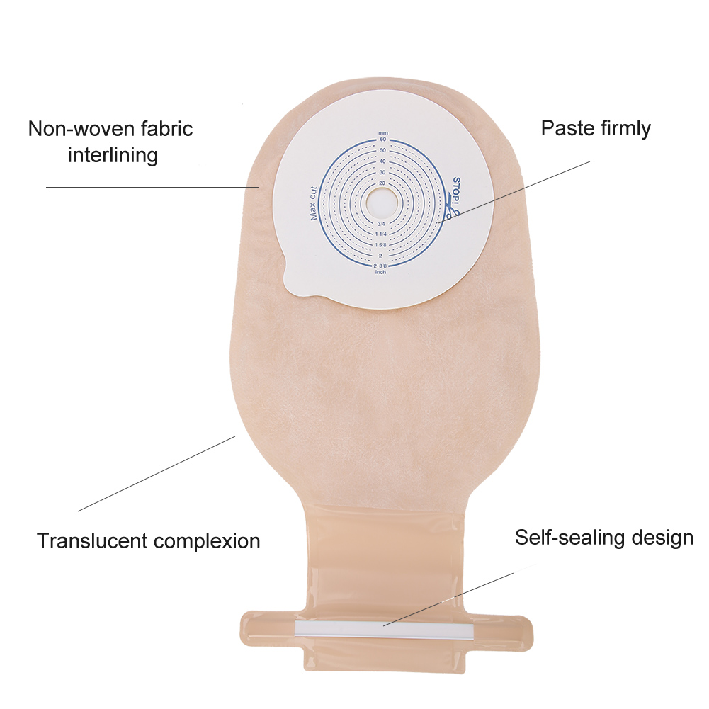
One Piece System Drainable Ostomy Bag
ADVANTAGES:
fewer components to apply
soft convex are available
feel lighter, more flexible and have a lower profile under clothing
DISADVANTAGES:
can’t be ‘burped.’
some can cost more if you are using closed-end models
(Ostomy Canada Society, 2023)

Slide 9
One Piece System Drainable Ostomy Bag

Slide 10
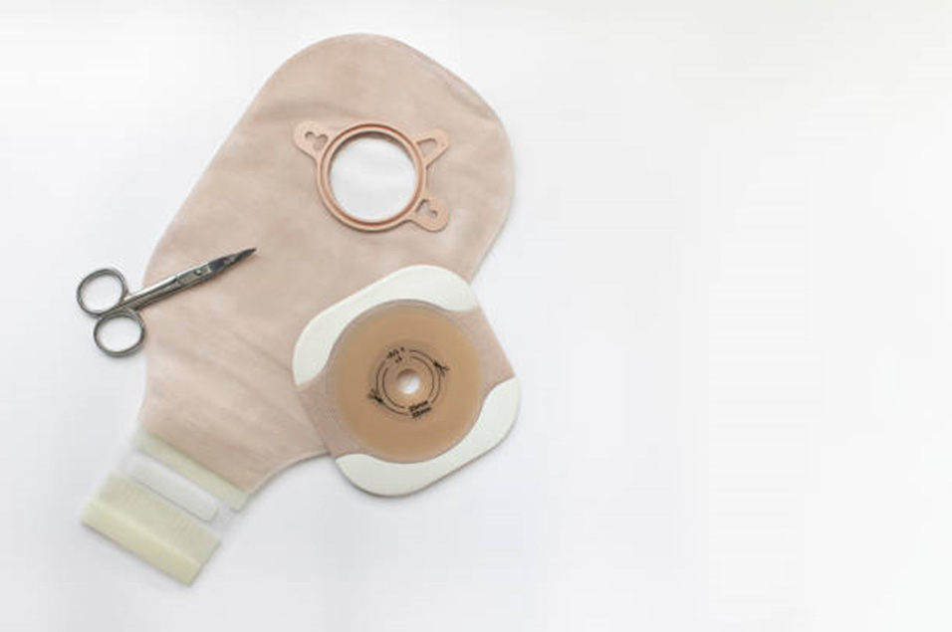
Two Piece Ostomy System
Advantages
Most are more effortless to ‘burp,’ that is, allow gas to escape.
A smaller or larger pouch can be substituted without having to change the entire flange
Disadvantages
Tend to be bulkier and more visible under clothing
(Ostomy Canada Society, 2023)

Slide 11
Colostomy Management

Slide 12
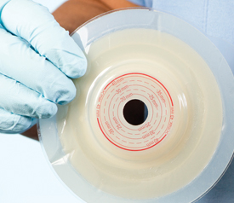
Colostomy Management

Slide 13
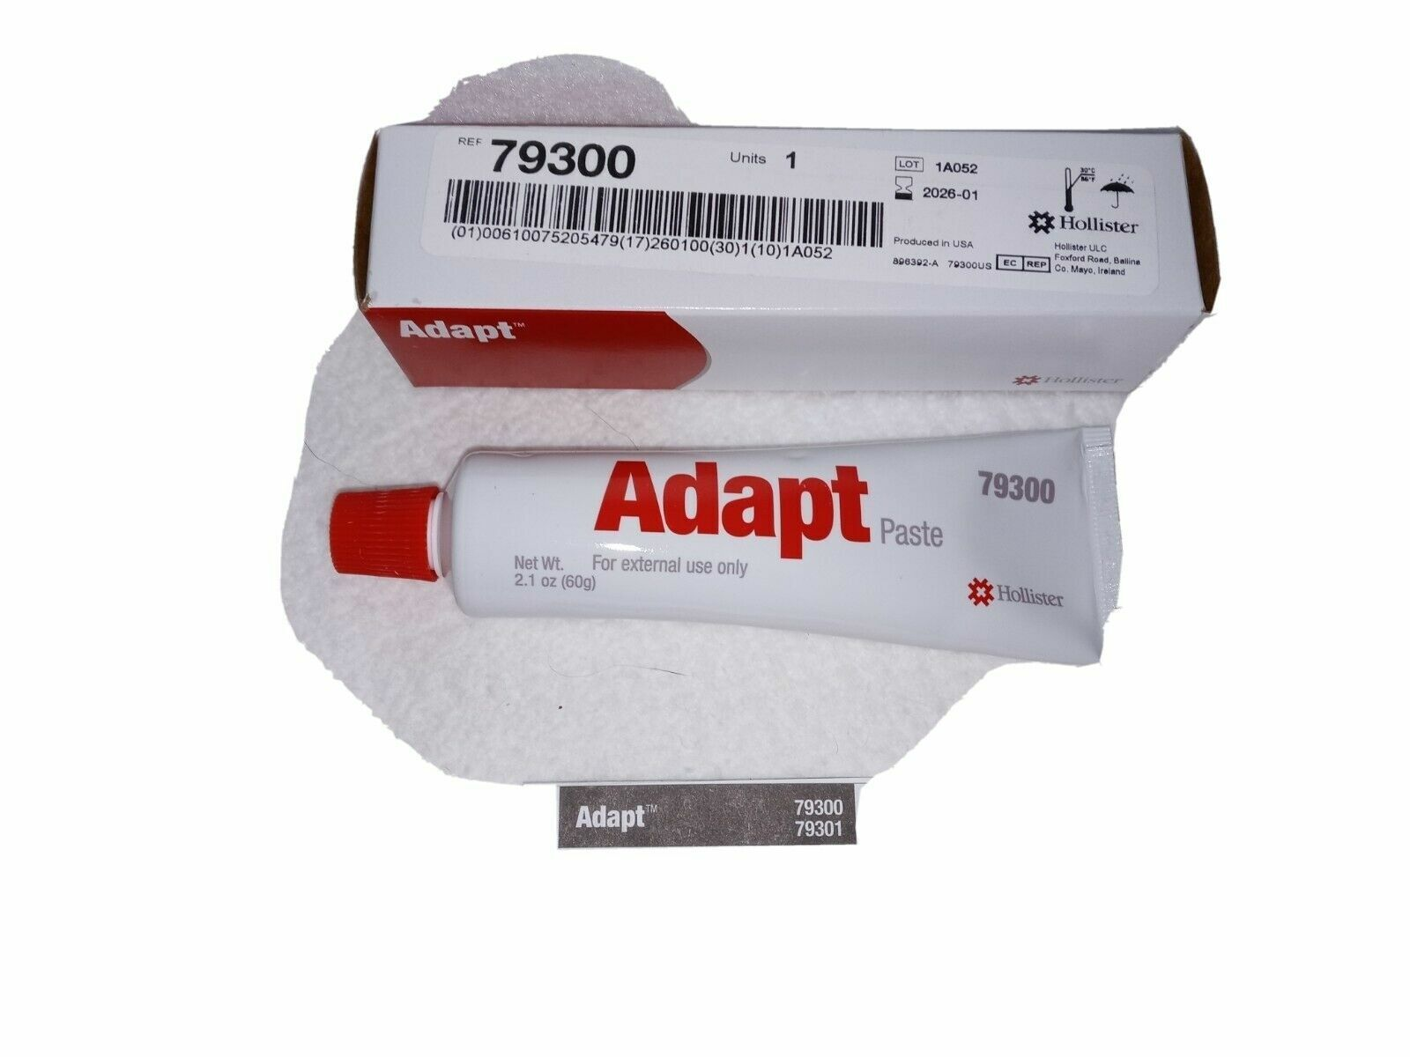
Stoma Adhesive Barrier Paste

Slide 14
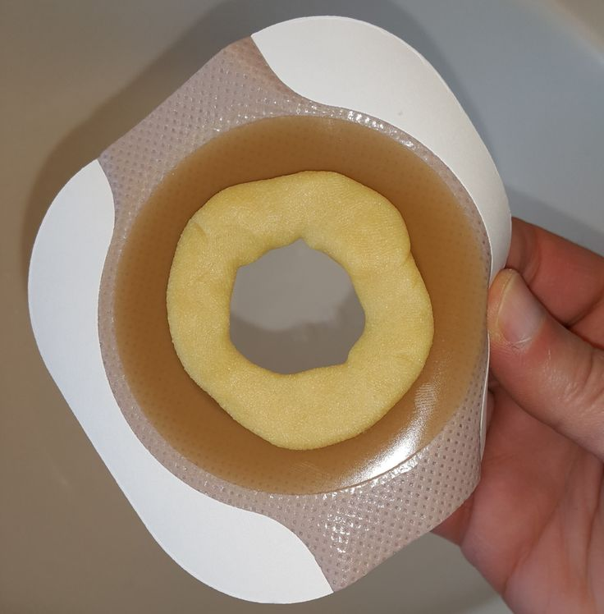
Stoma Adhesive Barrier Paste

Slide 15
Ostomy Care Supplies
One piece or two piece pouching system
Barrier Ring or barrier paste (Acts as Skin barrier)
Stoma Measurement Board
Pen
Ostomy Scissors
Gloves
Washed clothes/towel
(RNAO, 2019)

Slide 16
Ostomy Bag Pouch Change
Change ostomy bag pouch every 3-5 days
Empty the pouch when it’s half or 1/3 full
Change the pouch when the gut is least active
Clean stoma and surrounding with soap and water
avoid use of skin irritants (i.e. antiseptic solutions)
Measure stoma diameter with measuring card, then cut the barrier ring using ostomy scissors based on stoma size
Apply skin barrier/barrier ring around the stoma ensuring tight seal to prevent leakage
Check bag regularly to expel gas/air out of the system
(RNAO, 2019)

Slide 17
Ostomy Bag Pouch Change
Video
Ostomy Bag Pouch Change | Ostomy Care Nursing | Colostomy, Ileostomy Bag Change - YouTube

Slide 18
Nursing Care Priorities
Ensuring proper stoma care and maintenance.
Managing ostomy-related complications, such as skin irritation or leakage.
Educating patients on self-care and appliance management.
Certain foods are more likely to cause gas, diarrhea, constipation, incomplete digestion
Gas causing foods: Asparagus, beans, beer, broccoli, Brussels sprouts, cabbage, carbonated beverages, cauliflower, onions, peas
Promoting dietary adjustments to prevent blockages or other digestive issues.
Addressing body image and psychosocial concerns related to living with an ostomy.
(RNAO, 2019)

Slide 19
Gas and Constipation after Colostomy surgery
Dealing with Gas
Avoid eating beans, beer, broccoli, brussels sprouts, cabbage, cucumber, eggs, fish, garlic, onions
Use ostomy pouch with filter to allow gas to escape
Dealing with Constipation
Increasing fluid intake, taking a mild laxative, or increasing your fiber consumption
Avoid foods low in fibre: Applesauce, bananas, cheese, noodles, pretzels, white rice, white toast

Slide 20
References
Ostomy Canada Society (2023). What is an Ostomy / Types of Ostomies. Retrieved on June 20, 2023 from What is an Ostomy / Types of Ostomies - Ostomy Canada Society
Registered Nurses Association of Ontario [RNAO] (2019). Supporting Adults Who Anticipate or Live with an Ostomy. Retrieved on June 19, 2023, from Supporting Adults Who Anticipate or Live with an Ostomy | RNAO.ca

Slide 21
Thank You!

