Slide 1
Created by: Zankhana Patel, RN, MSN
William Osler-Nurse Practitioner Led Outreach Team (NLOT)
February 8, 2024

Slide 2
Nursing Assessment: Genitourinary & Gastrointestinal Systems

Slide 3
Learning Objectives
At the end of the presentation, learners will be able to:
Explain how to conduct specific body system focused nursing assessment
Perform thorough assessment GI and GU system: Inspection, auscultation, percussion, and palpation
Identify normal and abnormal assessment findings and related nursing interventions

Slide 4
Focused Assessments
GI System: responsible for the ingestion of food, the absorption of nutrients, and the elimination of waste products
Subjective data
Diet and exercise levels
Resident’s and his/her family history of gastrointestinal and genitourinary disease
Weight loss or gain in past 6 months
Difficulty swallowing food
Medications
Wounds
Hx or presence of foley catheter, suprapubic catheter, g-tube, colostomy, ileostomy etc
Any signs and symptoms of gastrointestinal and genitourinary disease
Abdominal pain, nausea, vomiting, bloating, constipation, diarrhea
Characteristics of urine and feces
Overflow diarrhea with use of laxatives

Slide 5
Focused Assessment: Gastrointestinal
Objective Data:
Conduct focused interview
Position: Place patient in supine if tolerated
Inspection: Visual examination
Auscultation: Listening to sounds from organs with stethoscope
Bell of stethoscope: Effective at transmitting lower frequency sounds
Diaphragm of stethoscope: Effective at transmitting higher frequency sounds
3) Percussion: Method of tapping body parts with fingers, hands, or small instruments as part of a physical examination
Determines size, consistency, and borders of body organs
Presence or absence of fluid in body areas
4) Palpation: Examination of system by touch of hands or fingertips
Identifies abnormal mass, lesions, tenderness, joint dislocation, fractures)

Slide 6
GI Tract

Slide 7
Abdominal Quadrants

Slide 8
Gastrointestinal System: Inspection
Visual examination of the abdomen: Symmetry and contour (shape of the abdomen), skin abnormalities, abdominal masses, lesions
Abdomen for distension, striae, scars, wounds/fistulas
Anus/rectum: Assess for hemorrhoids
Observe any abdominal movements associated with respiration, or any pulsations or peristaltic waves
Abdominal distension: Indicates ascites (i.e. associated with heart failure, cirrhosis, and pancreatitis.
Visible peristalsis with abdominal distension may indicate intestinal obstruction.
Shape of umbilicus: Inverted and midline. Assess for Umbilical hernia and bleeding
Inspect skin Color: Signs of Jaundice (yellow eyes & skin, dark urine and light-colored stool, itchiness)

Slide 10
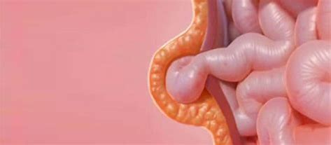
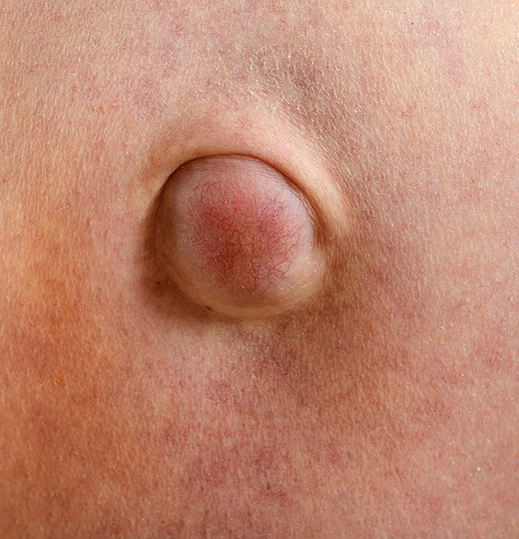
Inspection
Umbilical Hernia
Abdomen Contour

Slide 11
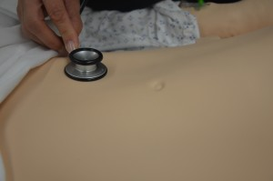
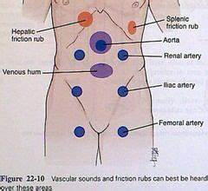
Gastrointestinal System: Auscultation
Auscultate bowel sounds (using Diaphragm of stethoscope) in all four quadrants before palpation & percussion
Hyperactive bowel sounds: Indicate bowel obstruction, gastroenteritis, or subsiding paralytic ileus.
Hypoactive or absent bowel sounds: May be present after abdominal surgery, or with peritonitis or paralytic ileus.
Abdominal artery Bruit: Swooshing sound from turbulence of blood flow (due to narrowing of artery/plaque formation)

Slide 12
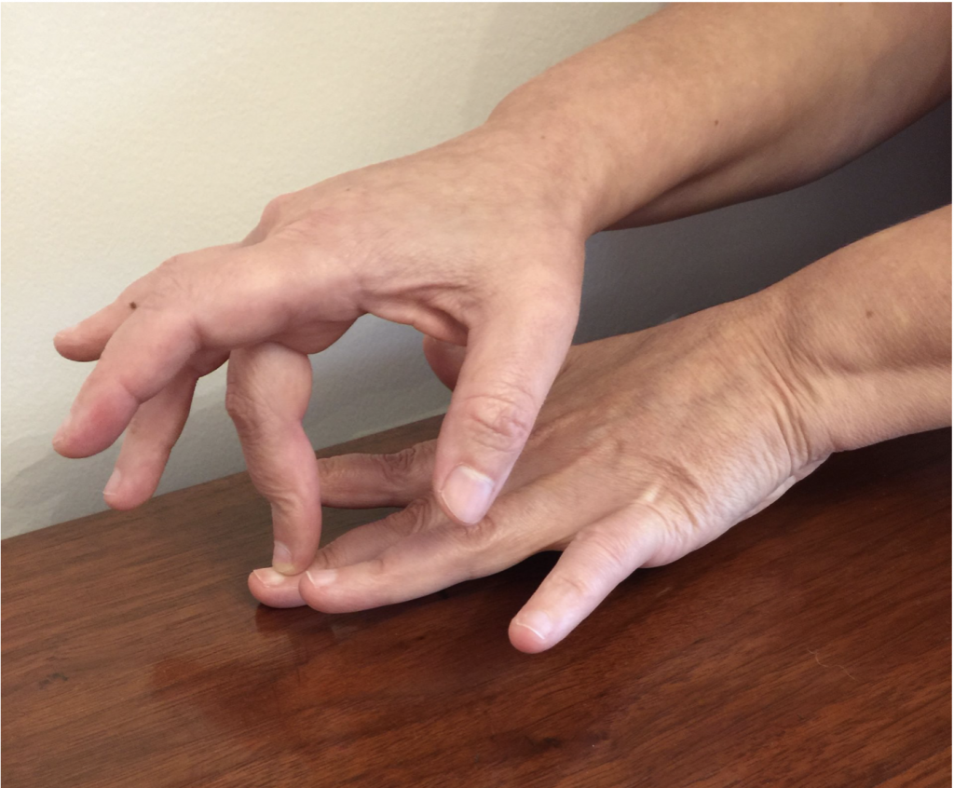
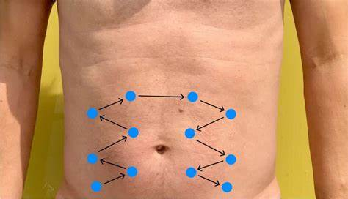
Gastrointestinal System: Percussion
Percuss using a zig-zag pattern beginning in the right lower quadrant and progressing clockwise
Symmetric route
To assess size and density of organs
Tympany: Heard over hollow organs due to air.
High pitched/drum-like sound
Small and large bowel, stomach
Dullness: Heard over solid organs or masses
Soft, muffled tone with little resonance, short duration
Liver, spleen
Pattern to Percuss the Abdomen

Slide 13
Gastrointestinal System: Palpation
Palpate abdomen lightly in all four quadrants.
Palpate to detect presence of masses and distension of bowel and bladder.
Pain and tenderness may indicate underlying inflammatory conditions such as peritonitis.
Megacolon: Abnormal dilation of colon related to paralysis of peristaltic colon movement
Causes: C.diff infection, loperamide (immodium)
S&S: Severe constipation, bloating, and abdominal pain or tenderness, fever, tachycardia
Rectal Exam for Impaction

Slide 14
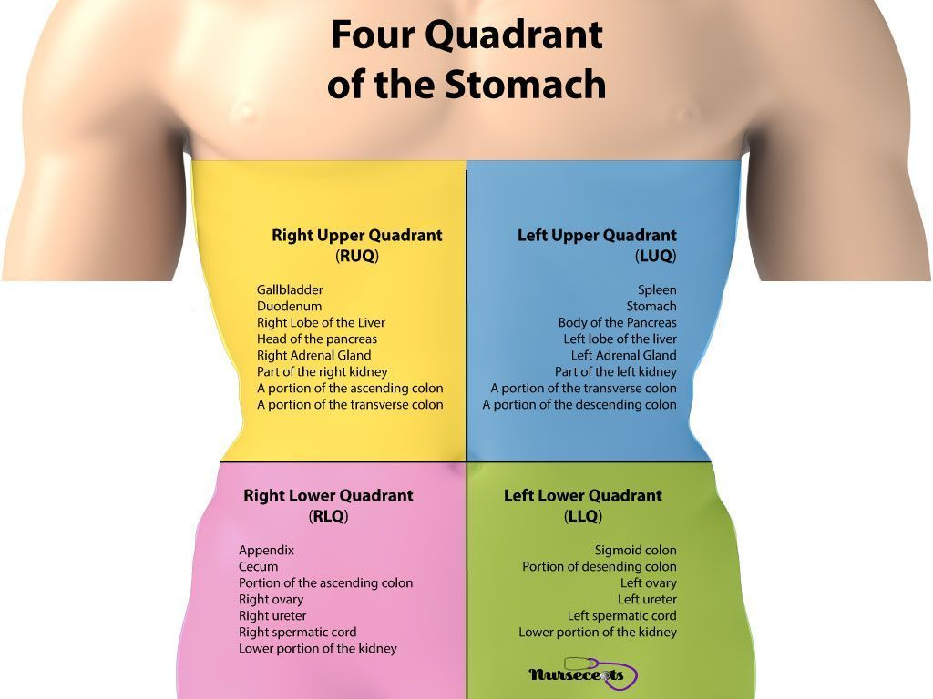
Video: Examination of the Abdomen
Abdominal Assessment - YouTube

Slide 15
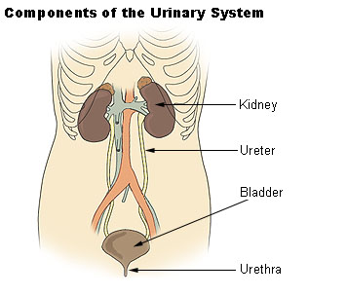
Genitourinary Assessment
Genitourinary Assessment
Inspection
Palpation

Slide 16
Genitourinary Assessment: Interview Questions
Surgical history
Hx of kidney or ureter stones
Hx of kidney disease
Hx of urinary tract infections (UTI)
Hx urine drainage tubes
Urine incontinence
Hx of benign prostate hyperplasia (BPH)

Slide 17
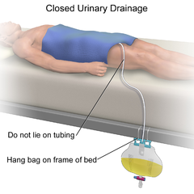
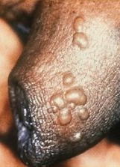
Genitourinary Assessment: Inspection
Observe for presence of urethral catheter, ileal conduit, nephrostomy tube(s), suprapubic catheter, and condom catheter.
Note the colour, presence, and nature of any odour, and volume of urine in the urine collection system.
Observe urinary meatus if urethral catheter present for signs of irritation, including skin integrity and urethral ooze.
Observe the genitalia, noting any lesions, blisters, edema

Slide 18
Genitourinary Assessment: Inspection
Urine drainage systems → Risk for development of UTI and other issues
Clinical definition of a UTI in non-catheterized residents
Acute dysuria (painful urination) alone OR
Two or more of the following:
Fever (oral temperature greater than 37.9 C or 1.5 C above baseline on 2 consecutive occasions within 12 hours)
New flank pain or suprapubic pain or tenderness
New or increased urinary frequency/urgency
Gross hematuria (blood in the urine)
Acute onset of delirium in residents with advanced dementia
(Public Health Ontario [PHO], 2019).

Slide 19
UTI Screening Guidelines: Non-catheterized LTC Residents
Routine screening for UTIs and treatment for asymptomatic bacteriuria in LTCH residents is NOT recommended
Do not perform screening annually or on admission
Unless the resident has the specific urinary signs and symptoms of a UTI, urine should not be cultured and antibiotics should not be prescribed
Obtain and store urine cultures properly to avoid contamination
Use of a clean catch or mid-stream collection or in/out catheterization and adherence to aseptic technique.
Store urine cultures under refrigeration if transport is not immediate.
(PHO, 2019).

Slide 20
UTI Screening Guidelines: Non-catheterized LTC Residents
Do not use dipsticks to diagnose a UTI.
Clinical symptoms of a UTI and a positive culture are required for a UTI diagnosis
Discontinue routine urine screening (e.g., at admission and annually) unless residents have clinical signs and symptoms of a urinary tract infection (UTI)
If the resident meets the clinical definition of a UTI
Encourage and monitor increased fluid intake for the next 24 hours unless contraindicated AND
Obtain urine culture
(PHO, 2019).

Slide 21
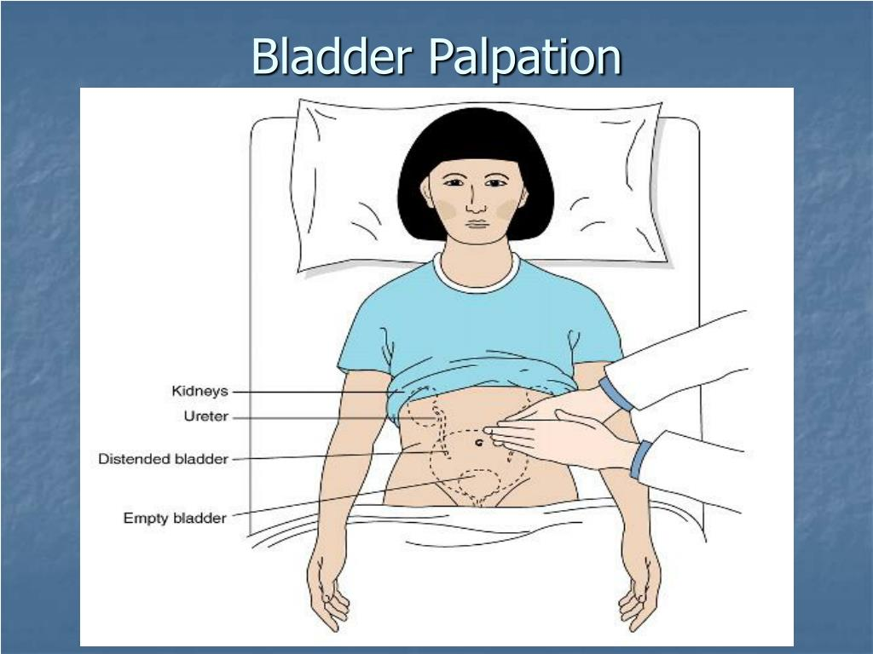
Genitourinary Assessment: Palpation
Palpate the suprapubic abdomen to assess for pain, possible urinary retention
While asking about pain or urgency may suggest urinary retention.
Urine retention: If hardness felt on palpation
Causes of retention: UTI, drug, immobility, fecal impaction
Assess for number of wet briefs
Assess for drainage or NO drainage of foley/Suprapubic catheter
Perform in & out catheterization for acute abdo pain/urine retention suspected.
Use bladder scanner if equipment is available.
Video
Basic Principles of Nursing Assessment: Genitourinary Assessment - YouTube

Slide 22
Expected vs. Unexpected Findings

Slide 24
References
Open Resources for Nursing (Open RN); Ernstmeyer K, Christman E, editors. Nursing Skills [Internet]. Eau Claire (WI): Chippewa Valley Technical College; 2021. Chapter 12 Abdominal Assessment. Available from: https://www.ncbi.nlm.nih.gov/books/NBK593213/
Public Health Ontario (2019). Urinary Tract Infection (UTI) Program: Implementation Guide. Retrieved on February 8, 2024 from Urinary Tract Infection (UTI) Program: Implementation Guide, Second Edition (publichealthontario.ca)

Slide 25
Thank You!

