Slide 1
Created by: Zankhana Patel, RN, MSN
William Osler-Nurse Practitioner Led Outreach Team (NLOT)
February 2, 2024

Slide 2
Peripheral IV therapy Management

Slide 3
Learning Objectives
To identify purpose of IV therapy
To discuss guidelines on peripheral IV insertion including peripheral IV site selection criteria
To learn about IV therapy requirements, its care and maintenance

Slide 4
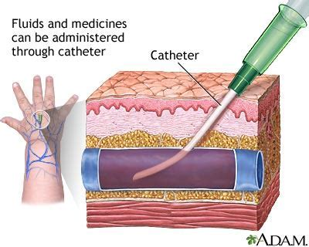
What is Peripheral Intravenous Access??
Thin, flexible tube/catheter that is inserted in peripheral veins to draw blood and administer treatments, like IV fluids, medications and blood transfusions.

Slide 5
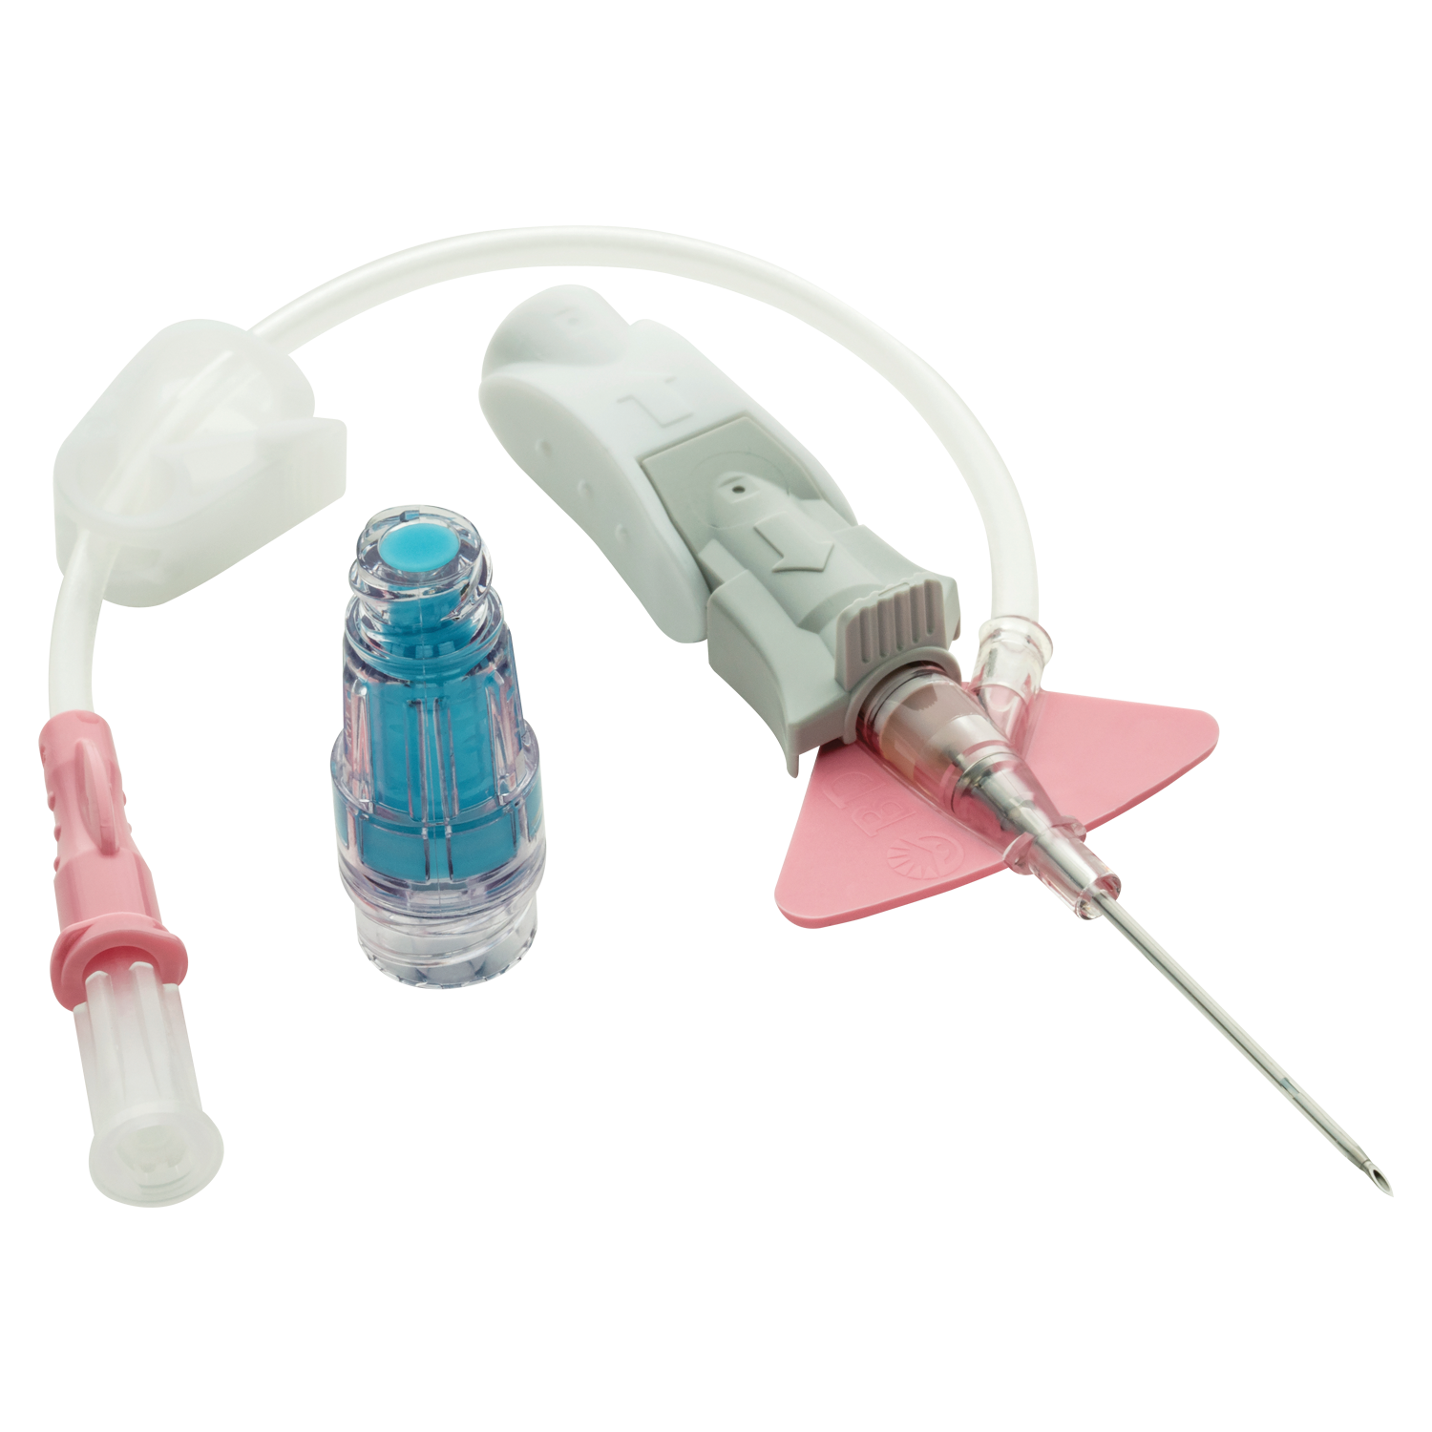
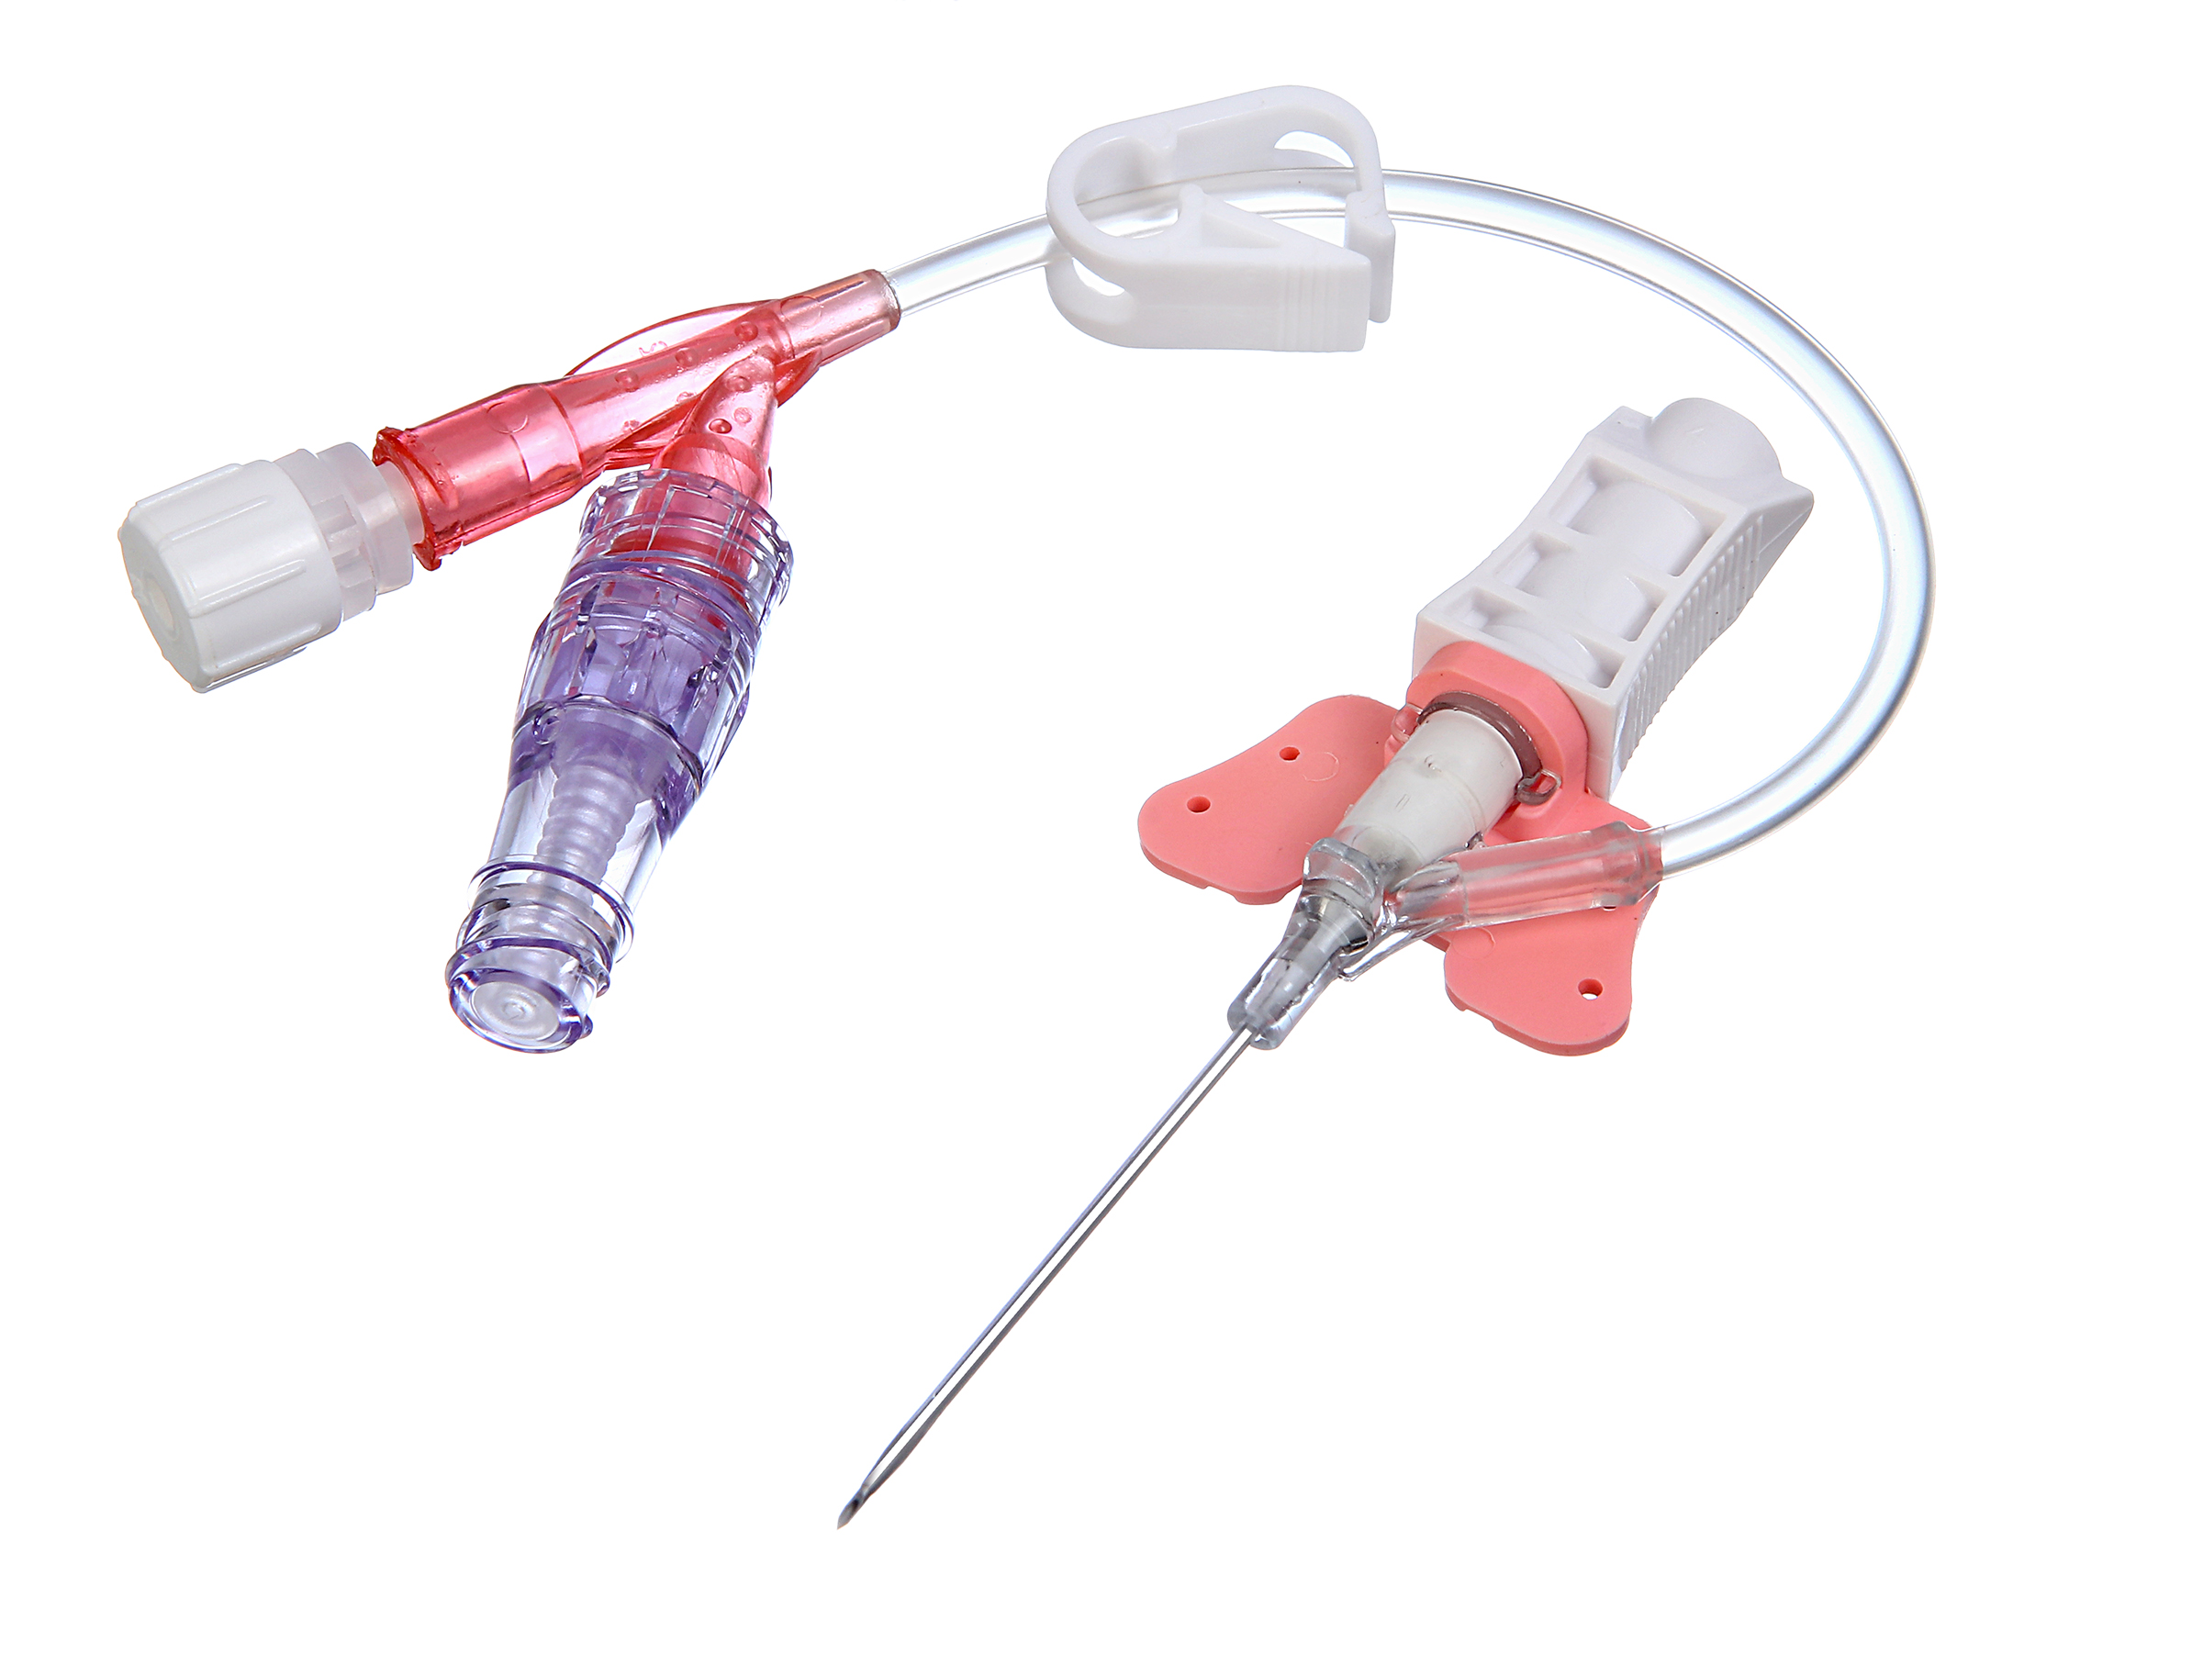
Various IV Cannulas

Slide 6
Peripheral Intravenous Access
An order is required to insert a vascular access device (PIV)
Clinician must be competent
Prior to inserting a (PIV), the clinician must provide patient education, address the rationale for the (PIV) placement; insertion process; expected dwell time; care and maintenance of the device; signs and symptoms of complications to report
Obtain informed consent from patient/SDM

Slide 7
Peripheral Intravenous Insertion
Safety engineered needles with blood control should be used
A closed IV system with integrated extension, blood control, and a build in stabilization device (i.e. BD Nexiva)
The insertion site must be cleansed with 2% Chlorhexidine/70% alcohol swab for 30 seconds using a vigorous scrub at every dressing change. Work from the insertion site outward. Allow area to dry for 30 seconds
Tourniquets are single patient use and will not be left on longer than 2 minutes.
The intended insertion site is not palpated after skin cleaning unless sterile gloves are worn
Never reinsert the same IV catheter as it is contaminated.
Never thread stylet back into the plastic cannula once it has been withdrawn as it could split or break cannula.
Documentation must be done routinely re: location, IV cannula size and assessment of IV site

Slide 8
IV Site Selection Criteria
Site selection should be initiated routinely in the distal areas of upper extremities
Veins in the lower extremities (i.e. legs) should NOT be used routinely in adults due to risk of tissue damage, thrombophlebitis, and ulceration.
Legs may be used ONLY if no other option is available
Veins in the upper extremities should NOT be used if previous surgeries/procedure involving upper extremity (i.e. side of breast surgery with axillary nodes removal, radiation therapy, AV fistula, cardiac shunts or affected side from CVA)

Slide 9
IV Therapy Requirements
Requires a prescriber order
Specifying the fluid type, volume, rate, medications, dosages and frequency of administration
Order is required to discontinue the catheter, discontinue IV fluids, or convert to saline lock as per facility’s policy
For residents receiving multiple infusions:
Compatibility must be verified prior to the initiation of infusions
Each infusion must be primed/prepared independently before setting up the next infusion
Routine IV NS flush: requires order

Slide 10
Ongoing Care and Maintenance
Nurses must assess for signs and symptoms of phlebitis minimally every 4 hours.
Findings must be graded, documented, and reported to the prescriber/MRP.
Continued need for all peripheral IV lines must be reviewed daily
Administration sets and solutions must be labeled with date and time.
All intravenous solution fluid bags must be changed every 24 hours
Intravenous site, line tubing, dressing, and needle free connectors must be changed every 96 hours.
Securely tape IV tubing using medical/paper tape
(Registered Nurses’ Association of Ontario, 2021; William Osler Health System, 2022).

Slide 11
IV Supplies & Equipment
IV Solution
IV administration tubing or dial-a-flow tubing
IV catheter with blood control (prevents bleeding)
Closed IV catheter system with integrated extension and stabilization platform (i.e. Nexiva)
Needlefree connector extension tubing
2% Chlorhexidine and 70% Alcohol cleanser
Tourniquet (single use)
0.9% sodium chloride prefilled syringe
Securement device (for IV catheter with Autoguard)
Gloves non-sterile
Additional PPE if required (mask, eye protection, gown)
Arm board if required
Sharps container
Labels for dating site, tubing and IV bag
IV pump
Transparent dressing
Tape
5cm x 5cm (2"x 2") gauze or clean cotton swab – optional

Slide 12
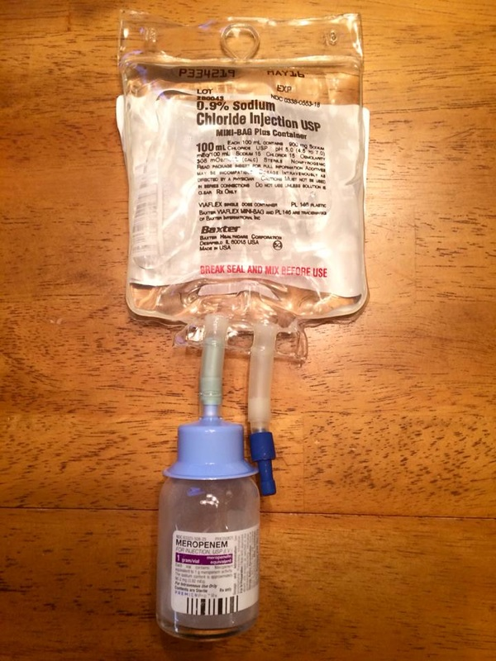
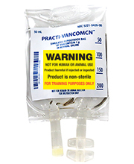
IV bags

Slide 13
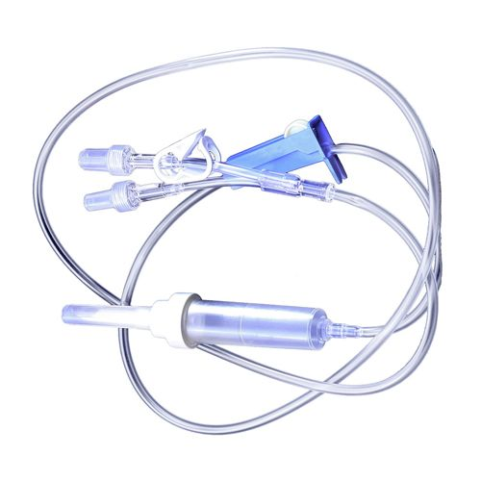
Primary Line Tubing

Slide 14
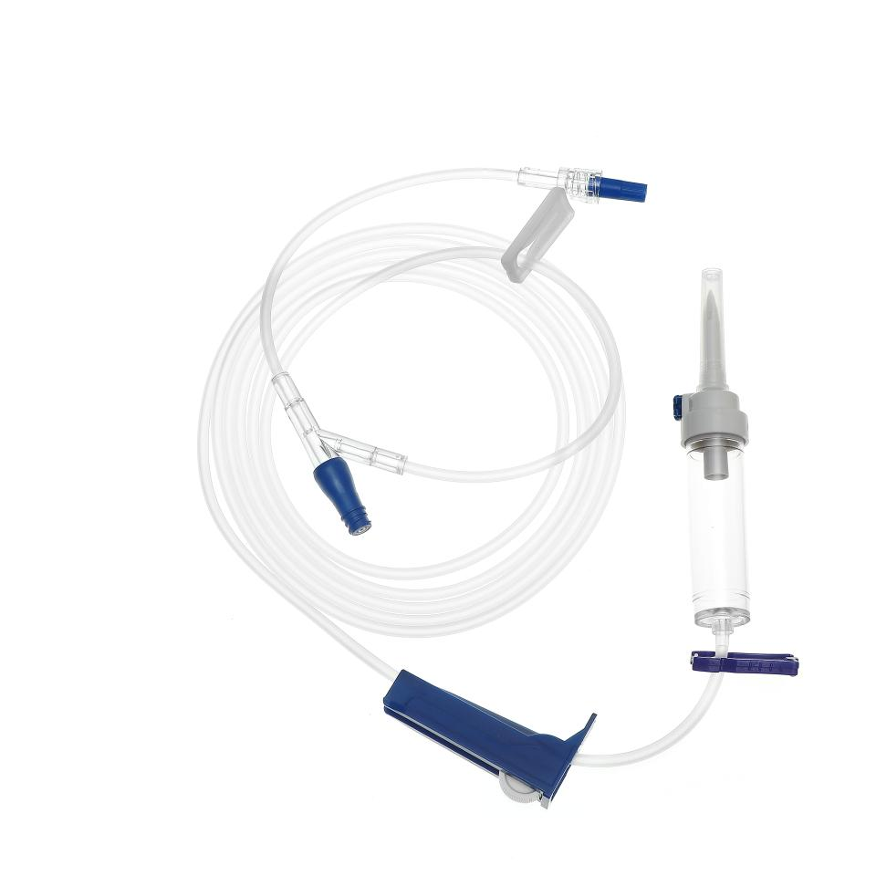
Primary Line Tubing

Slide 15
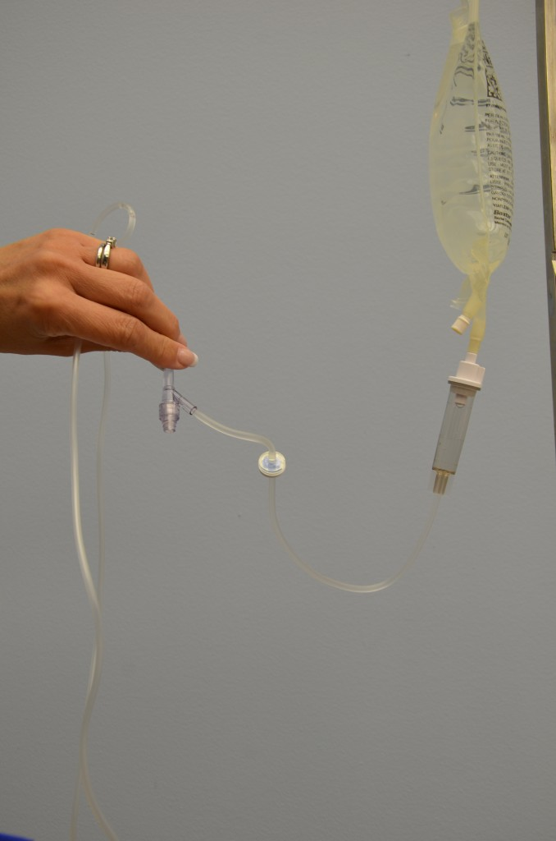
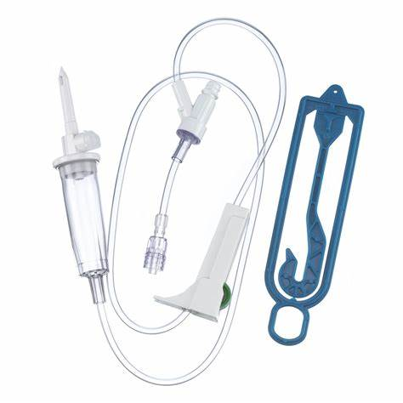
Secondary Line Tubing

Slide 16
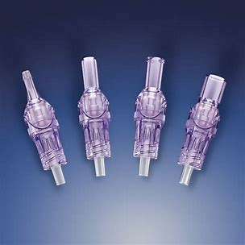
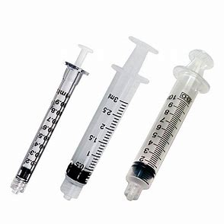
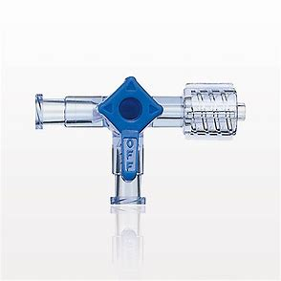
Needleless connectors
Luer-lock syringes
3-Way Stopcock with Luer-lock
Luer-lock syringes
Luer-lock/Needless Connectors

Slide 17
IV Insertion Procedural Steps
Perform hand hygiene
Gather supplies.
Explain procedure to resident/family.
Don gloves and additional PPE if required.
Locate peripheral vein to be used for IV insertion
Cleanse the site with Alcohol Prep Swab 70% or Chlorhexidine swab stick for at least 30 seconds using a circular motion in concentric circle beginning at the target point and working out

Slide 18
IV Insertion Procedural Steps
7) Insert IV catheter using blood control system at the targeted vein
8) Verify placement of catheter by checking for blood return.
9) Once blood return noted, connect 10 mL NS prefilled syringe and flush the line
10) Assess for swelling at insertion during flushing
11) If no swelling noted, IV line is placed in the vein
12) Apply transparent sterile dressing then securement device
13) Label dressing with date, time & pneumonic.
How to Start an IV | IV Catheter Insertion & Flush Technique in Hand | Nursing Skill - YouTube

Slide 19
Flushing IV Lines
The total volume displayed on the minibag/IV syringe medication will be infused
Medications prepared on unit in mini-bags should be added to the total volume to be infused (i.e. 50 mL NS with 10 mL of antibiotic solution = 60 mL TBI)
Flush with prefilled 0.9% NS syringe after medication administration via a secondary line or needless connector.
Needleless connectors should be flushed Q8H when dormant or when accessed (i.e pre & post medication, post blood product infusion, and post blood sampling).
(Registered Nurses’ Association of Ontario, 2021; William Osler Health System, 2022).

Slide 20
Add-on Devices
All add-on devices must be cleansed with 2% chlorhexidine/ 70% alcohol for 30 seconds and allowed to dry completely before accessing
All devices shall be of luer-lock design to ensure a secure junction.
Connectors, stopcocks, extension sets, filters, needle free connectors, etc. must be located as close to the catheter site as possible
All air shall be purged from syringes, administration sets, needle free connectors, and all "add on devices" before connection to the catheter
(Registered Nurses’ Association of Ontario, 2021; William Osler Health System, 2022).

Slide 21
IV Site Dressings
A ll sites will be covered with a transparent sterile occlusive dressing to allow visualization
All PIV line dressings must be labeled with the date, time and user name (mnemonic).
Must be changed every 96 hours and PRN as required.
(Registered Nurses’ Association of Ontario, 2021; William Osler Health System, 2022).

Slide 22
Documentation
Complete documentation of the procedure and routine monitoring in health record every shift & PRN as per facility’s policy:
Type, length, gauge, time, location of insertion site, attempts, date of insertion, and patency of site
Assessment of IV site: patency, signs of phlebitis (redness, swelling, pain, discharge from IV insertion site), circulatory assessment
Resident’s response to any treatments given
Document & report to prescribing clinician if unable to insert catheter.
Document removal of PIV as per prescriber’s order.
PIV flushes and changed to saline lock documented in resident’s record
Types and amounts of IV solution and/or medication given
(College of Nurses’ of Ontario, 2008; Registered Nurses’ Association of Ontario, 2021; William Osler Health System, 2022).

Slide 23
References
College of Nurses’ of Ontario (2008). Practice Standard: Documentation. Retrieved from Practice Standard - Documentation, Revised 2008 (cno.org)
Registered Nurses’ Association of Ontario (2008). Nursing Best Practice Guidelines Shaping the Future of Nursing: Care and maintenance to reduced vascular access complication.
Registered Nurses’ Association of Ontario (2021). Best Practice Guideline: Vascular Access. Retrieved from Vascular_Access_FINAL (2).pdf
William Osler Health System (2022). Peripheral Intravenous Initiation and Management Adult Patients Policy.

Slide 24
Thank You!

