Slide 1
Created by: Zankhana Patel, RN, MSN
William Osler - Nurse Practitioner Led Outreach Team (NLOT)
March 6, 2024

Slide 2
Blood Sampling in Adults in LTC Setting

Slide 3
Learning Objectives
To identify the purpose of phlebotomy
To discuss best practice recommendations on venipuncture and blood sampling procedure and guidelines
To identify required supplies and equipment for blood sample collection
To learn about important factors affecting blood test results

Slide 4
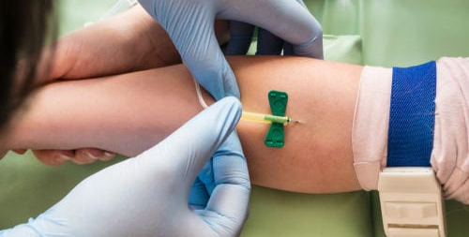
What is Phlebotomy??
The surgical opening or puncture of a vein in order to withdraw blood or introduce a fluid
Important tool and routine procedure for diagnostic testing for many medical conditions

Slide 5
Venipuncture Guidelines
The Clinician must possess the knowledge, judgment and skills required to perform venipuncture.
All Clinician must comply with best practice guidelines and adhere to strict infection control principles including aseptic technique when performing these procedures.
Consent
Patient Identification process must be completed prior to obtaining blood sample and before labelling specimen Two unique identifiers must be verified
Vacutainer tops must not be removed nor blood transferred from one vacutainer to another.
All venipuncture needles are one time use only. If the venipuncture is unsuccessful, the needle must not be reinserted
(William Osler Health System [WOHS], 2021).

Slide 6
Venipuncture Guidelines
Resident must be assessed for possible risks associated with venipuncture, for example, anticoagulant therapy, low platelet count, bleeding disorders
Venipuncture must be limited to two attempts per Clinician to a maximum of four attempts. The ordering health care provider must be notified and unsuccessful attempts must be documented in the resident's record.
When vein selection, cleansing, and access take longer than 1 minute, the tourniquet must be released. Clinical must wait a minimum of 2 minutes to reapply the tourniquet to minimize the effect of hemoconcentration.
Chlorhexidine swab is the recommended skin prep; alternative agent may be used if allergy noted (i.e. alcohol swab)
(WOHS, 2021).

Slide 7
Venipuncture: Site selection
Recommended site in adults = Antecubital fossa
Preferred sites = Medium cubital and cephalic veins
Nurses may perform venipuncture from all sites. All other personnel are limited to the antecubital fossa.
An order must be obtained prior to accessing veins of an adult when using the lower extremities for blood draw. These veins should not be used routinely in adults due to the risk of tissue damage, thrombophlebitis and ulceration.
(WOHS, 2021).

Slide 9
Venipuncture: Site selection
DO NOT attempt venipuncture in the following:
Arm on side of mastectomy with lymph node dissection
Pre-dialysis patient (use hands only)
Hemiplegic hemiparesis (on affected side)
Same arm of Blood Transfusion
Same arm as central line
Existing intravenous or saline lock site (Due to risk of hemolysis)
Hemodialysis shunt (AV fistula)
Burned or Scarred Areas
Hematoma
Infection site
For hemodialysis patient, the forearm is avoided to preserve are for hemodialysis shunt.

Slide 10
Venipuncture: Site selection
Drawing blood specimen from an arm that has an intravenous line is not recommended → Risk of hemolysis. If there is no other viable option:
Specimens should not be obtained above an IV site, as this affects the integrity of the sample causing erroneous test results.
Blood collection may be performed distal to (below) the infusion site if no other viable option.
Infusions must be stopped for a minimum of two minutes prior to and during blood sampling.
The tourniquet must be applied at least 10 cm (4 inches) below the IV site, when drawing distal to an infusion IV.
(WOHS, 2021).

Slide 11
Order of Draw
The order of draw shall be followed. Blood cultures shall be drawn first.
Fill tube to appropriate fill volume as indicated on the tube.
(WOHS, 2021).

Slide 12
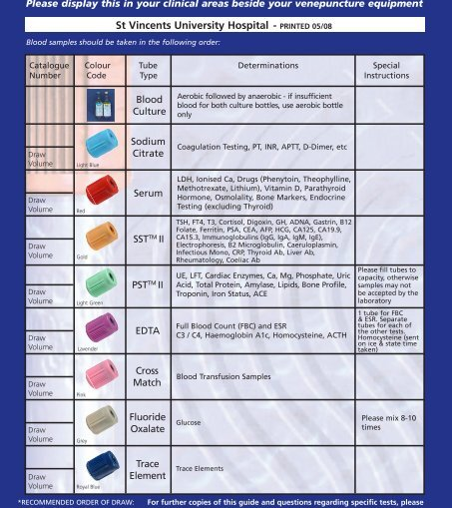
Order of Draw Tube Guide
Blood Culture Bottles
Coagulation Tubes
Tube with NO ADDITIVES
Other tubes with ADDITIVIES

Slide 14
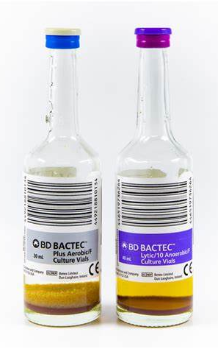
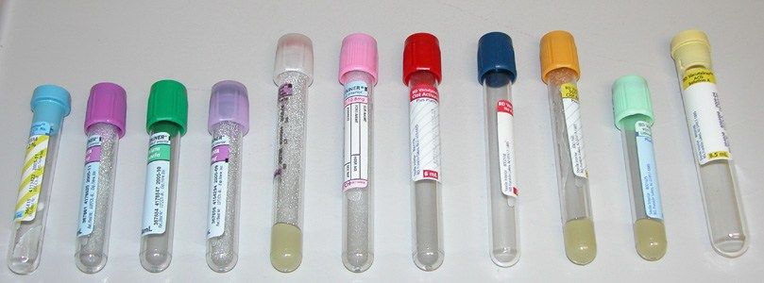
Blood Collection Tubes

Slide 15
Sampling Blood Cultures
Obtain blood cultures prior to initiating antimicrobial therapy, with a prescribers orders.
Set of blood cultures = Aerobic and anaerobic samples.
Aerobic samples must always be collected first, as the winged devise has a small amount of air in the extension tubing and can be placed safely in the aerobic culture bottle without altering the results. If there is difficulty collecting sufficient blood for both aerobic and anaerobic samples, the aerobic blood culture is the desired culture.
Two blood culture sets should be taken within 24-hour period
The dust cap from the new blood culture bottle must be removed and the top of each bottle must be cleansed rigorously with 2% Chlorhexidine Gluconate and 70% isopropyl alcohol, allowing to air dry completely prior to obtaining blood specimen into the bottle.
(WOHS, 2021).

Slide 16
Sampling Blood Cultures
Blood cultures may be collected serially (separated by a time interval) or simultaneously (separate site, separate venipuncture, not separated by specific time interval.
For adults, the first set should consist of an aerobic as well as an anaerobic bottle. Each sample should be filled with 8-10mL of blood per bottle, as per manufacturer's recommendations.
The second set consist of only an aerobic bottle.
(WOHS, 2021).

Slide 17
Labeling of Specimens
All specimens must be labeled at the patient's point of care by the collector immediately after collection and be labelled with:
Patient full name
Unique identifier
Date and time of collection
Mneumonic of collector (legible)
The label will be placed over the manufacturers label ensuring that the label is flat and straight
Do not write on barcode
Place label vertically when possible over the manufacturer label
(WOHS, 2021).

Slide 18
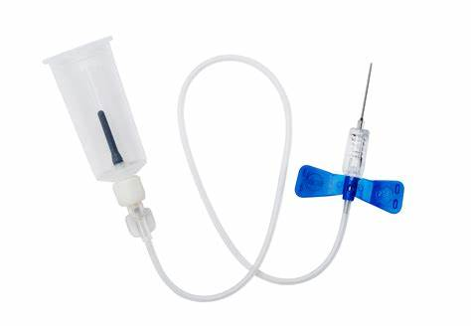
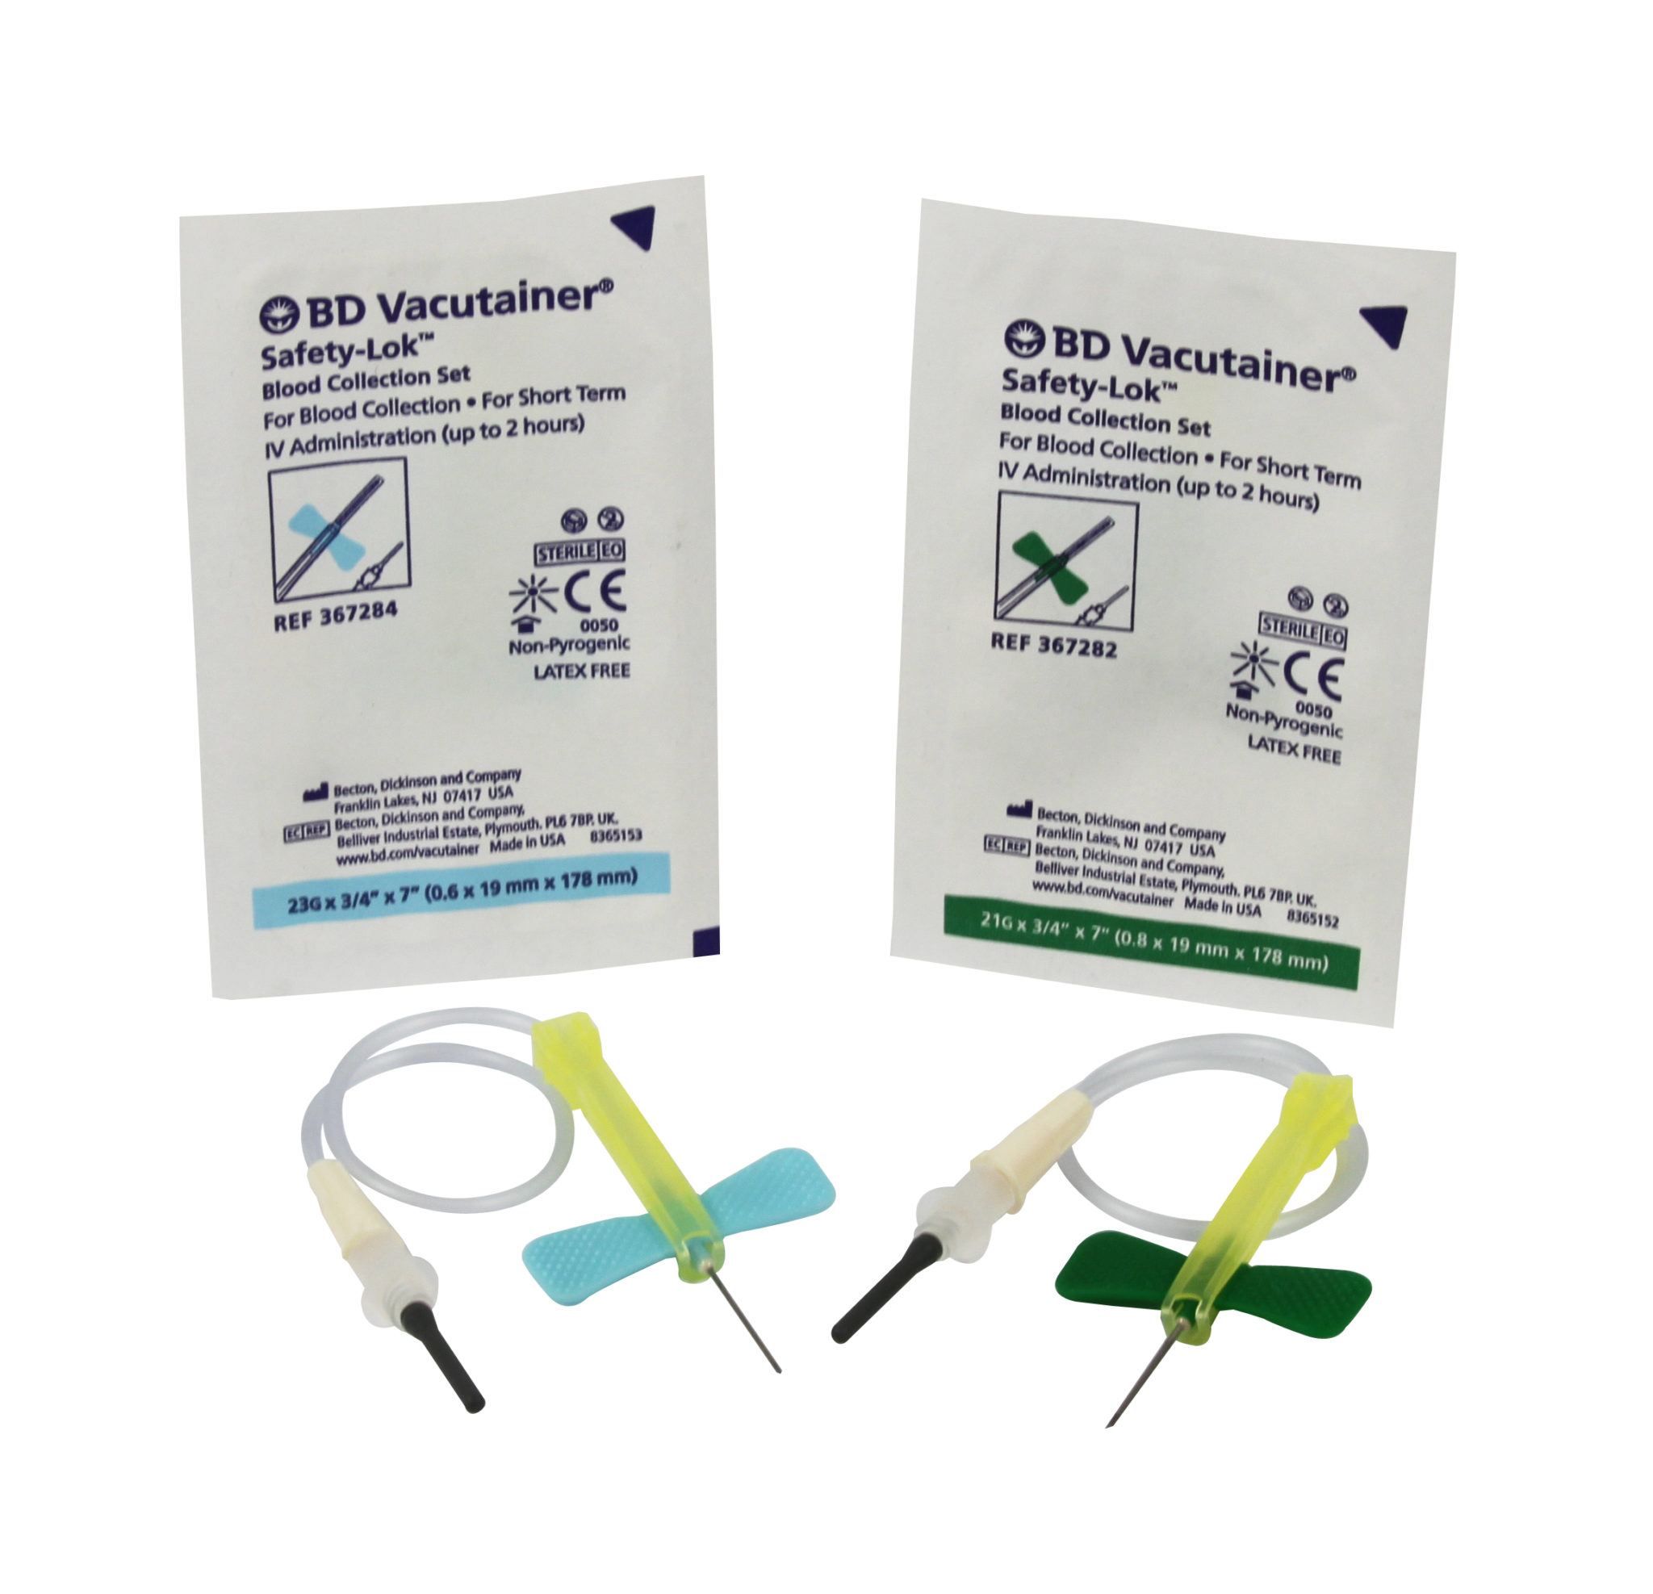
Supplies and Equipment
PPE as required
Clean gloves
(2%) Chlorhexidine Gluconate and 70% Isopropyl OR Alcohol swabs
Single use disposable Tourniquet
2 x 2 sterile gauze
Tape or Bandage
Single use Vacutainer
Safety engineered blood collection set
Blood tubes
Appropriate Bio-hazard plastic bag for specimen transportation
Appropriate Bio-hazard Sharps disposal container

Slide 19
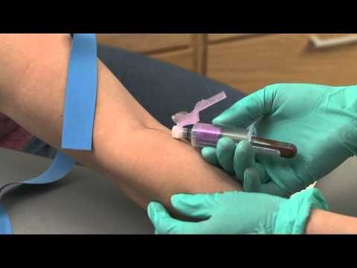
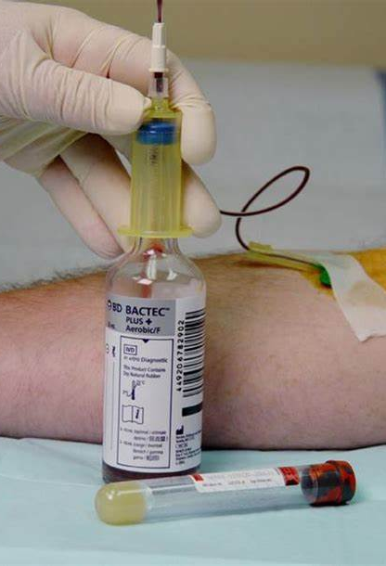
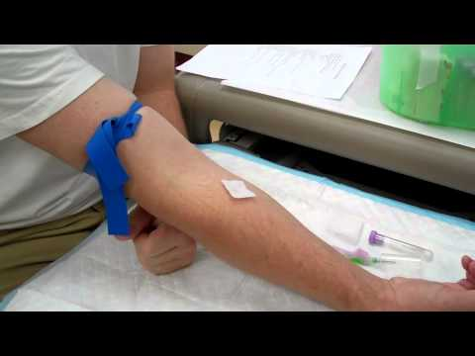
Supplies and Equipment

Slide 20
Factors Affecting Blood Test Results
Not allowing alcohol to air dry causes specimen hemolysis
Not following order or draw can cause contamination of additives can interfere with test results
Improper mixing (i.e. excessive or vigorous shaking) of tube can cause hemolysis
Inadequate mixing can cause clotting or presence of clots in the specimen
Leaving the tourniquet on longer than one minute may result in hemoconcentration and errors in protein based analytes such as PRBC
Collection below or above the IV can lead to contamination or dilution of the specimen contamination
Using a syringe to collect a specimen can cause hemolysis when transferring blood into the Vacutainer tube when the force is applied to syringe
Drawing blood specimen must NOT be taken form a peripheral intravenous catheter due to risk of hemolysis.
(WOHS, 2021).

Slide 21
References
Registered Nurses’ Association of Ontario (2021). Best Practice Guideline: Vascular Access. Retrieved from Vascular_Access_FINAL (2).pdf
William Osler Health System (2021). Blood Sampling in Adult and Paediatric Patients Policy.

Slide 22
Thank You!

