Slide 1
Created by: Zankhana Patel, RN, MSN
William Osler-Nurse Practitioner Led Outreach Team (NLOT)
February 15, 2024

Slide 2
Oxygen Therapy and Nursing Management

Slide 3
Learning Objectives
At the completion of this module, learners will be able to understand:
Oxygen therapy indications
Signs and symptoms of hypoxemia
How to determine if someone needs oxygen?
CO2 Retention
Delivery of Oxygen
Oxygen Safety and storage in LTC
Infection Control

Slide 4
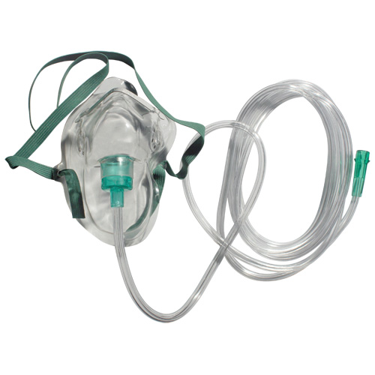
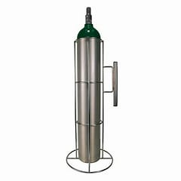
What is Oxygen ?
Oxygen is an odorless, tasteless, and colorless gas at normal atmospheric temperature and pressure
Oxygen makes up approximately 21% of the atmosphere
Oxygen is a combustible, non-flammable gas
Oxygen in supplemental form is considered a drug and requires a physician’s order
(VitalAire Canada, 2024).

Slide 5
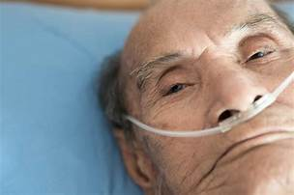
Oxygen Therapy Indications
Who requires O2?
Residents requiring oxygen may have the following conditions:
COPD, chronic bronchitis, emphysema
Short term reversible conditions
Heart failure and pneumonia
Cancer
Palliative diagnosis or at end-of-life
Acute episodes (i.e. MI, angina, stroke)
(VitalAire Canada, 2024).

Slide 6
Signs and Symptoms of Hypoxemia
Respiratory | Neurological | Cardiac
Increased RR | Anxiety | Increased HR
Dyspnea/SOB | Lethargy | Arrythmias
Accessory muscle use | Irritability | Low BP
Shallow or cessation of breathing | Impaired judgment | Cyanosis
 | Headaches
(VitalAire Canada, 2024).

Slide 7
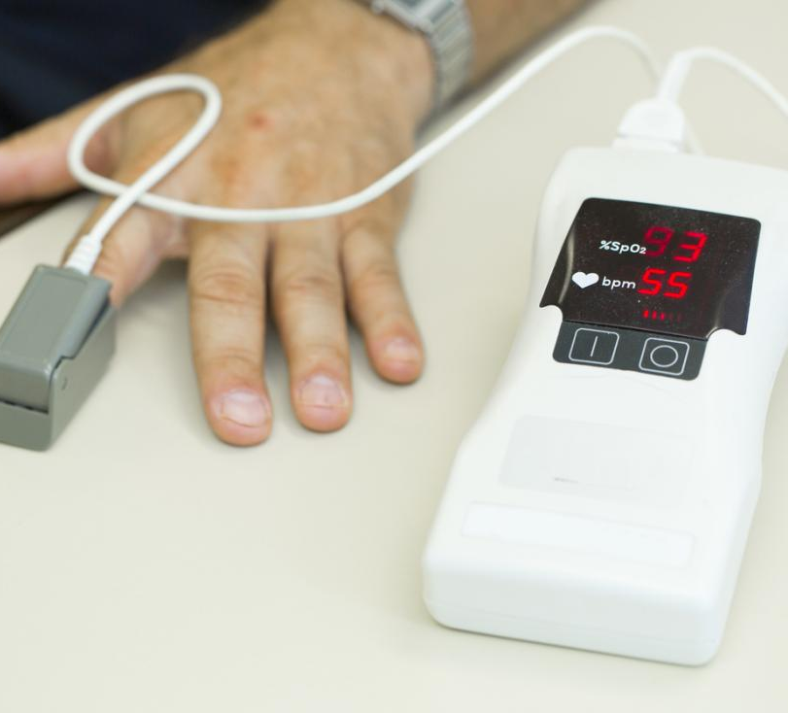
How to determine if Someone needs Oxygen?
Testing Blood oxygen level by:
Oximetry: SpO2 must be 88% or less for 2 consecutive minutes while resting on room air
Sampling blood from an artery (ABG): PaO2 = 55 mmHg or less on room air at rest
(VitalAire Canada, 2024).

Slide 8
CO2 Retention
Definition: PCO2 Greater than 45mmHg with a pH of 7.35-7.45
Chronic hypercapnic residents (i.e. COPD) may not respond to hypoxic stimulus for ventilation
Some COPD residents will have hypercapnia which can be worsened with supplemental oxygen → O2 therapy should be used with caution → Goal of SpO2 between 88%-92% for COPD residents
(VitalAire Canada, 2024).

Slide 9
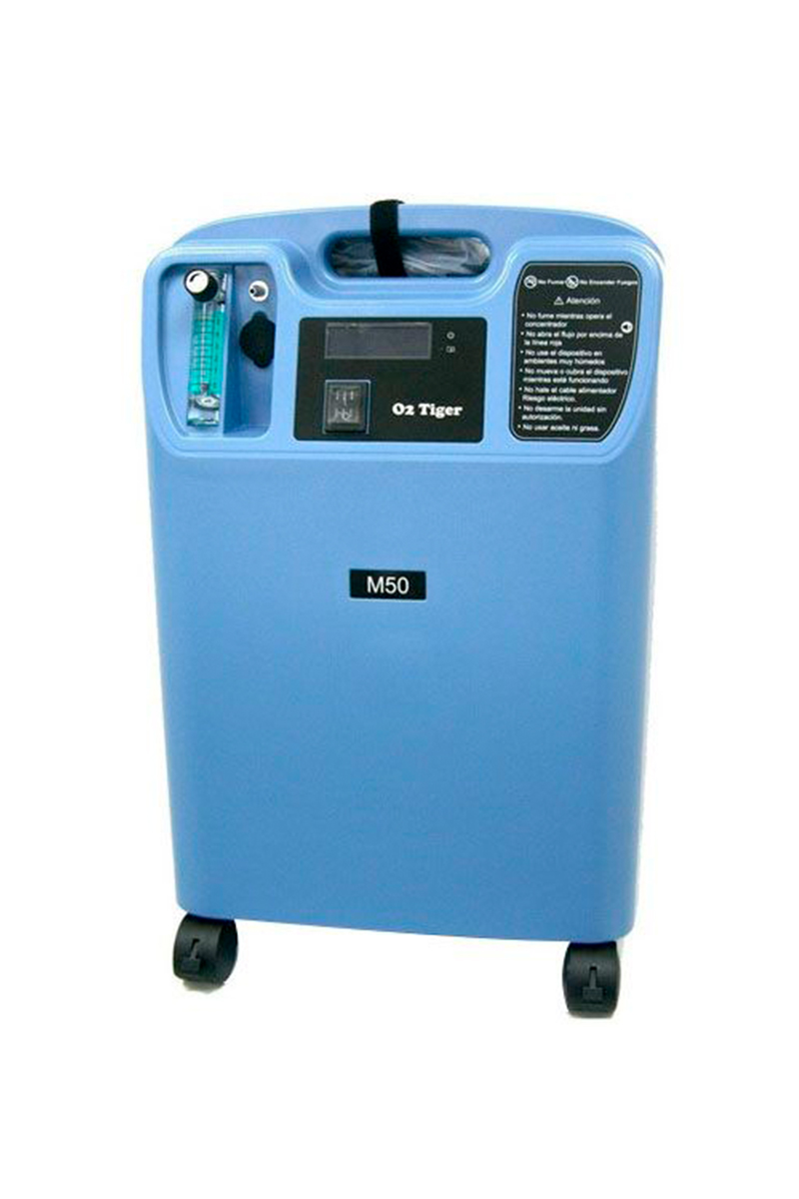
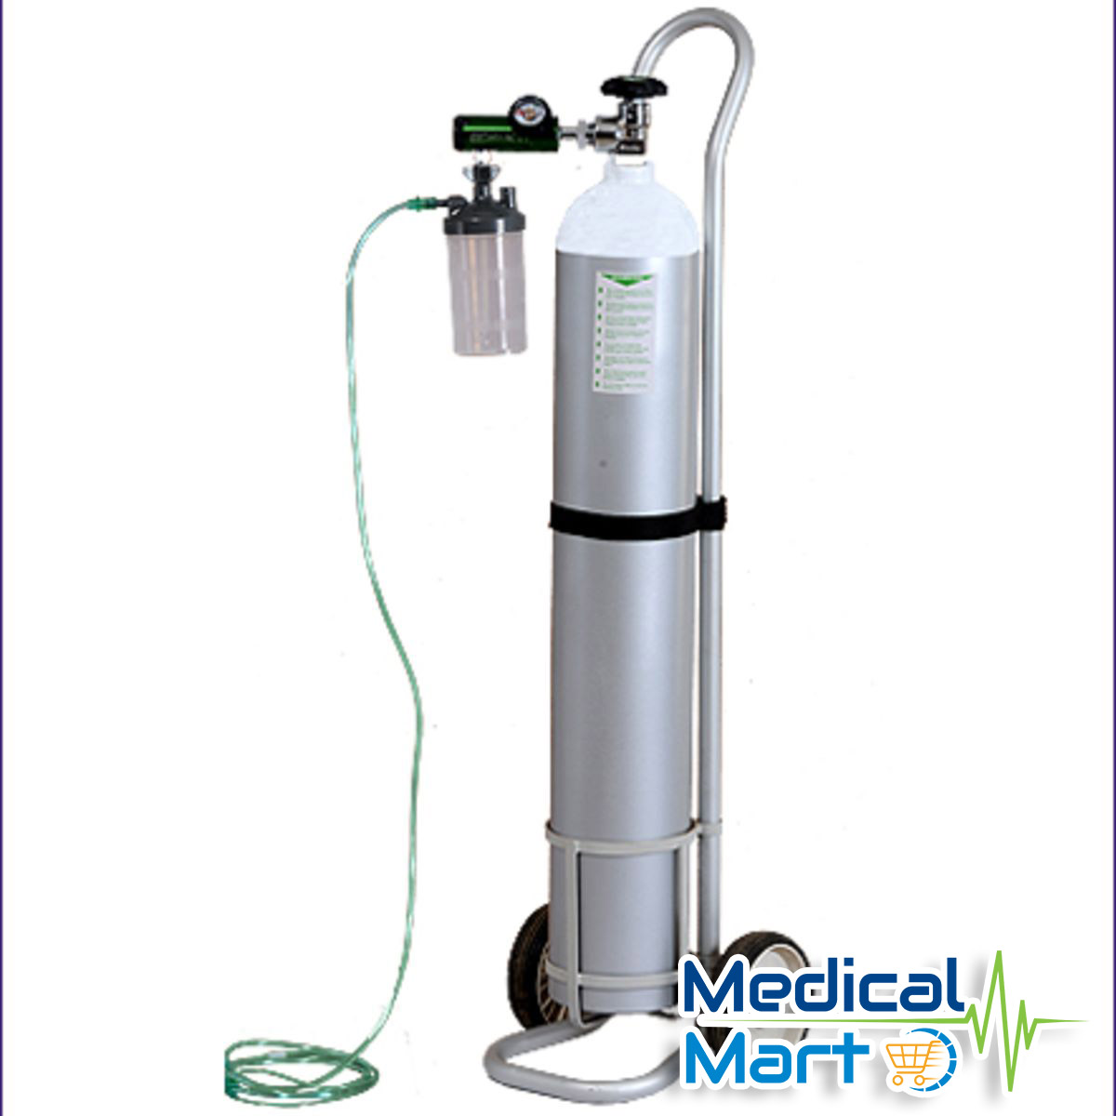
Delivery of Oxygen
In LTC setting, oxygen is commonly delivered in two ways:
Oxygen concentrators
Nasal cannula: Provides oxygen at low flow rates
Maximum O2 given: Up to 5L/min
Rates above 5 L/min → Result in discomfort to the patient, drying of the nasal passages, and possibly nose bleeds (epistaxis).
Portable Oxygen cylinders
(VitalAire Canada, 2024).

Slide 10
Low and High Flow Oxygen Delivery Devices
Low flow Devices
High flow Devices
Recommended in LTC
Nasal Cannula (Most common)
Nasal Catheter
Transtracheal Catheter
NOT Recommended in LTC
Simple Mask
Partial Rebreather Mask
Non-Rebreather Mask
Venturi Mask
Nebulizer
Nasal High Flow Oxygen Therapy
Mechanical Ventilators (invasive Non-invasive)
CPAP/APAP Machines
Resuscitation Bags
Oxygen Concentrator: Setup and Use - YouTube
(College of Respiratory Therapists of Ontario [CRTO], 2013).

Slide 11
Oxygen Therapy & Humidity
Humidity refers to the water vapour content of a gas
Supplemental medical gas is generally cool and dry → Cause drying of the secretions and mucosa potentially leading to airway obstruction and tissue injury
Humidity therapy is therefore an integral part of oxygen therapy.
Clinical Signs and Symptoms of Inadequate Airway Humidification
Atelectasis
Dry, non-productive cough
Increased airway resistance
Increased incidence of infection
Increased work of breathing
Substernal pain
Thick dehydrated secretions
(CRTO, 2013).

Slide 12
Low Flow Oxygen Humidifiers
Molecular Humidity - bubble type humidifiers, bubble-diffuser type humidifiers used with nasal cannula.
Humidity is not indicated at flows less than 4 L/min
Video: Humidifier set up for an oxygen concentrator (youtube.com)
(CRTO, 2013).

Slide 13
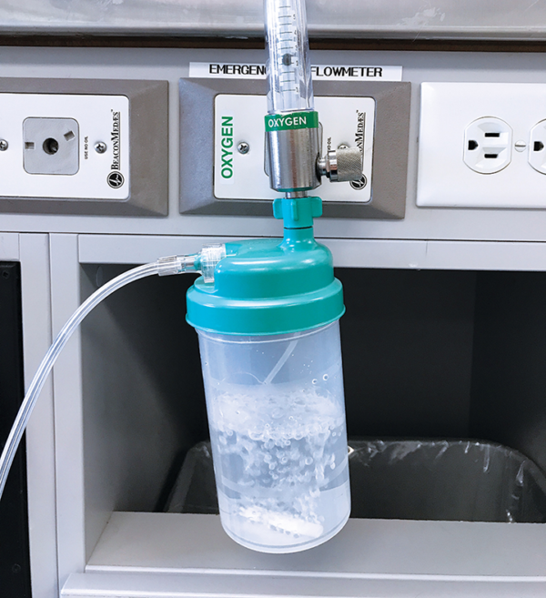
Humidified Oxygen Therapy

Slide 14
Valid Oxygen Prescription
Oxygen therapy requires written order by MD/NP
A valid order consists of quantity and duration of use
i.e. Rx: Provide oxygen via nasal cannula at 2 L/min for 24 hours
Nursing directives apply only for 24 hours
(VitalAire Canada, 2024).

Slide 15
Documentation
Individual residents’ care plans and medicine administration records must detail:
Reason for home oxygen use
Who prescribed it
Prescribed flow rate
Duration and device used
The oxygen monitoring plan
Details of target oxygen saturations
(CareQuality Commission, 2022).

Slide 16
Safe Use of Oxygen
Ensure MD/NP orders are obtained for oxygen therapy within the timeframe of your facility’s policy
NO smoking, open flames or sparks within 6 feet of oxygen equipment or tubing – OXYGEN IN USE sign must be posted on residents’ door
Avoid use of petroleum products (Vaseline and Purell), flammable and combustible materials near oxygen
Do not use flammable liquids, such as paint thinners or aerosols, near oxygen.
Be familiar with location and use of fire suppression equipment within the LTC home
Do not store concentrators or liquid oxygen in confined spaces (i.e. closets)
DO NOT set flows higher than prescribed
Ensure that fire alarms and smoke detectors are working.
(VitalAire Canada, 2024).

Slide 17
Storage of Oxygen
Follow the manufacturer's advice on how to store oxygen.
Store oxygen cylinders:
Securely to prevent the cylinder from falling
Away from areas that would block escape routes or fire exits
In well ventilated areas
Away from heat and light sources (i.e. heaters)
In an area that is not used to store any other flammable materials (i.e. aerosols)
Away from combustible material (such as paper, cardboard, curtains)
Store oxygen concentrators upright. Plug them directly into the mains. Do not use an extension lead.
Place statutory hazard notices in areas where you store oxygen. This includes the person's bedroom.
Oxygen cylinders have an expiry date. Check the dates regularly
(CareQuality Commission, 2022).

Slide 18
Infection Control
Concentrators and portables required surface disinfection between each resident use with a germicidal agent and a clean cloth
Nasal cannula should be replaced every 4 weeks
Clean equipment should be segregated from dirty equipment
(VitalAire Canada, 2024).

Slide 19
Oxygen: Potential Complications and Hazards
As with all medical therapies, consider the risks and benefits of using supplemental oxygen
Common Complications:
Absorption atelectasis
Apnea with loss of respiratory drive in patients with chronic respiratory failure (i.e. COPD) → Spo2 Goal = 88%-92% for residents with COPD
Retinopathy of prematurity
Oxygen toxicity
Fire hazard
All related equipment should be checked and maintained in good working order because loss of oxygen therapy in a hypoxic patient could be devastating

Slide 20
References
CareQuality Commission (2022). Managing oxygen in care homes. Retrieved from Managing oxygen in care homes - Care Quality Commission (cqc.org.uk)
College of Respiratory Therapists of Ontario (2013). Oxygen Therapy Clinical Best Practice Guideline. Retrieved Oxygen Therapy (crto.on.ca)
VitalAire Canada (2024). Long Term Care Facilities: Reliable Oxygen delivery. Retrieved from Oxygen Therapy in Long Term Care Facilities | VitalAire Canada

Slide 21
Thank You!

