Slide 1
Created by: Zankhana Patel, RN, MSN
William Osler-Nurse Practitioner Led Outreach Team (NLOT)
August 1, 2024

Slide 2
Post-Fall Assessment & Management

Slide 3
Learning Objectives
At the end of the presentation, learners will be able to:
Identify the necessary components of the nurse’s initial post-fall assessment
Name potential complications and injuries that can occur from a fall
Identify nursing interventions applicable to stabilize a resident during the initial post-fall assessment

Slide 4
Post Fall Assessment and Management
Immediate response: When a resident has a fall, staff are required to undertake rapid assessment and basic life support (if required) and complete observations.
Observations & ongoing monitoring: Undertake further observations and monitoring as the resident may develop symptoms later that can indicate serious changes in their condition.
Older people who fall are at risk of intracranial injury due to physiological changes in the brain.
Early signs of deterioration are fluctuating behaviours (increased agitation, restlessness or changes in alertness – lethargy, flattened) or increasing confusion.
Ongoing monitoring is important.
(American Association of Post-Acute Care Nursing [AAPACN] , 2021).

Slide 5
Prior to Moving a Resident Post-Fall
Before a resident can be moved, the nurse must assess for:
Injury to the spinal column
Obvious fractures
Significant bleeding
Level of consciousness
Resident’s vital signs
Assess location and intensity of pain, respiratory status, circulation, and for signs and symptoms that a post-fall injury has occurred.
(AAPACN , 2021).

Slide 6
Post Fall Assessment and Management
Assessment of injuries
The most common fall-related injuries sustained by a geriatric resident include the following:
Musculoskeletal injuries, such as hip fracture or muscle tear
Dislocation of joints, such as the shoulder, hip, or cervical spine
Head and neck injuries, such as a subdural hematoma or cervical fracture
Skin and deeper-tissue trauma, such as bruises, abrasions, skin tears, or internal bleeding
Examine the cervical spine and immobilise if there is any indication or potential for a spinal injury. If there is any sign of injury, staff are to contact MD/NP for a clinical review.
Signs of injury may include: Bruising, lacerations, swelling, redness, abrasions, shortening of limbs, restricted limb movement, external rotation of lower limbs, inability to weight bear, pain on applying pressure, and signs of deformity.
All patient fall events, treatment plans and revised interventions are to be documented in the resident health record.
(AAPACN , 2021).

Slide 7
Assessment of injuries
The following changes post-fall indicate an injury has occurred:
Vital signs – The resident’s pulse, blood pressure, and respiratory rate may be elevated from the initial trauma and fear of the fall, but changes from the resident’s normal baseline could also indicate an injury.
Cognition – The resident’s ability to think has been compromised. He or she may appear confused, disoriented, or emotional.
Loss of consciousness – The resident loses consciousness or goes in and out of consciousness.
Muscle strength or sensation – The resident’s ability to push, pull, or move has been compromised, or the resident is unable to feel touch, pressure, or a part of the body.
Range of motion to a joint – The resident’s ability to move a joint freely has been compromised, or the joint is hyperextended.
Deformity of head or neck – The resident’s head has a swollen, depressed, or open area. The resident’s neck is not in alignment with the resident’s spine.
Skin integrity – The resident’s skin is bruised, discolored, swollen, or open from a fracture.
(AAPACN , 2021).

Slide 8
Assessment: Fracture of an Extremity
Signs & symptoms:
Pain (may or may not be severe)
Swelling and bruising
Tenderness
Decreased feeling in the area surrounding the fracture
Change in the range of motion, position, or alignment of a joint or extremity
Inability to put weight on an extremity or unable to use an extremity
Hip fracture
Bruising and swelling on and around the hip
Shorter leg on the side of the hip fracture
External or outward rotation of the leg on the side of the hip fracture
(AAPACN , 2021).

Slide 9
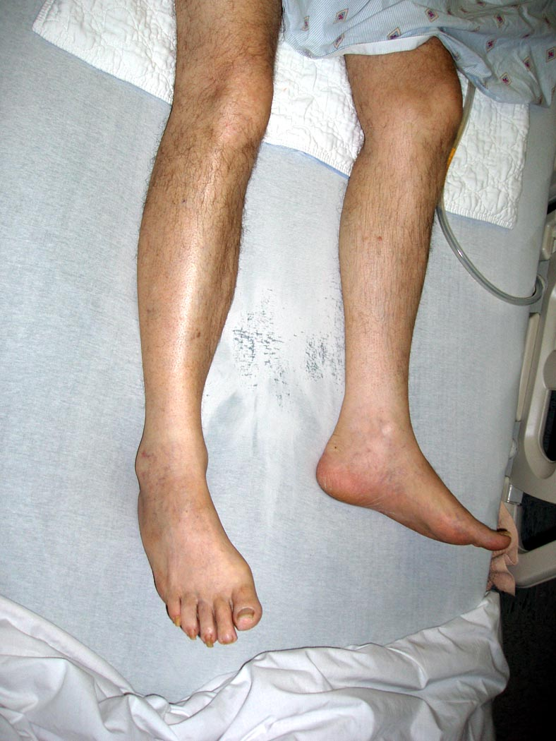

Slide 10
S & S: Cervical or Spinal Fracture
Pain (may or may not be severe)
Swelling and bruising
Tenderness
Tingling, or change in sensation in the extremities
Decreased feeling in the arms or legs
Muscle weakness or paralysis of the arms or legs
NOTE: If there are signs of an injury to the spinal column, a fracture, significant bleeding, or the resident’s level of consciousness has changed, do not move the resident. Call EMS and provide supportive care until EMS arrives.
(AAPACN , 2021).

Slide 12
Neurological Assessment
Assessment of neurological status, often called a “neuro check,” should be done when a resident hits his or her head or if it is unknown if they hit their head (unwitnessed fall)
The signs of a subdural or epidural hematoma include:
Unequal or enlarged pupil in one eye
Nausea or vomiting
Lethargy
Reduced level of consciousness
Significant weakness of one or more of the extremities
Confusion or change in cognitive ability
Headache
Slurred speech
Dizziness and impaired balance
(AAPACN , 2021).

Slide 13
Falls Risk Management Tool
Falls Risk Management Post Falls Review
Outlines four key steps in a post-falls review:
Assess for injury and provide immediate care
Monitor for 24–48 hours
Conduct a post-fall huddle and reassess falls risk factors, and
Modify the care plan/ interventions
(Registered Nurses’ Association of Ontario [RNAO], 2017).

Slide 14
Nursing Care
If a resident sustains an injury that can be managed within the facility, follow the physician’s orders, in addition to conducting thorough follow-up assessments
i.e. Skin tear → keep the site clean, apply a dressing per the physician’s orders, assess for infection and barriers to healing
Individualize care to address the resident’s medical needs, encourage healing, and prevent further injury
(AAPACN , 2021).

Slide 15
Universal Falls Precautions Poster

Slide 16
Universal Falls Precautions Poster

Slide 17
Falls Debriefing and Action Plan

Slide 18
Falls Debriefing and Action Plan

Slide 19
References
American Association of Post-Acute Care Nursing [AAPACN] (2021). Post-fall assessments. Retrieved on July 31, 2024 from AAPACN_Post-Fall-Assessment.pdf
Registered nurses’ Association of Ontario (2017). Preventing Falls and Reducing Injury from Falls Best Practice Guideline. (4th Ed.). Retrieved on July 31, 2024 from Universal Falls Precautions Poster.pdf (rnao.ca)

Slide 20
Thank You!

